Slide 1
Interpret and Predict Race Points
Sports Analytics – STAT 6341
Presenter: Léon Yuan
Instructor: Dr. South

Slide 2
Outlines
Introduction
Aims and Consumers
Literature Review
Data Sources
R Shiny Demonstration
Bayesian Linear Mixed Model
Machine Learning Models
Limitations
Future Work
Conclusions

Slide 3
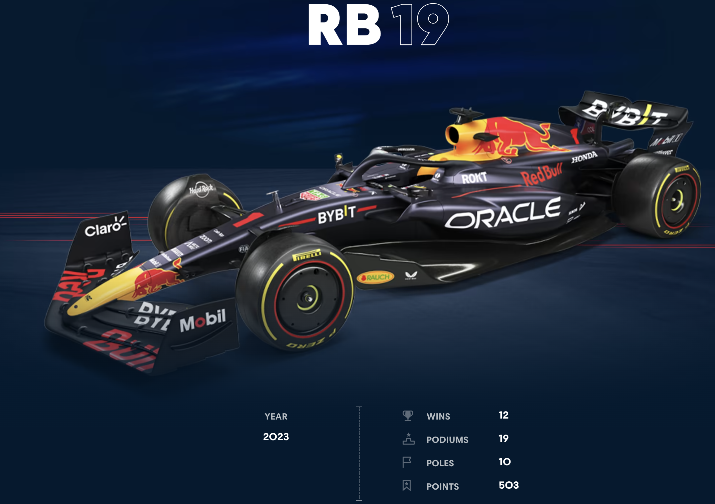
Introduction
Formula 1 is the most cutting-edge auto technology and fastest race sport in the world.
It is an international sport, including more than 20 countries, 5 continents involved.
It is a very expensive sport. On average, one present Formula 1 race car is between $12 and $20 Million.
It is a team sport instead of a single racer. (Pit Stops)
Video for Beginner

Slide 4

All the teams in 2021 F1

Slide 5
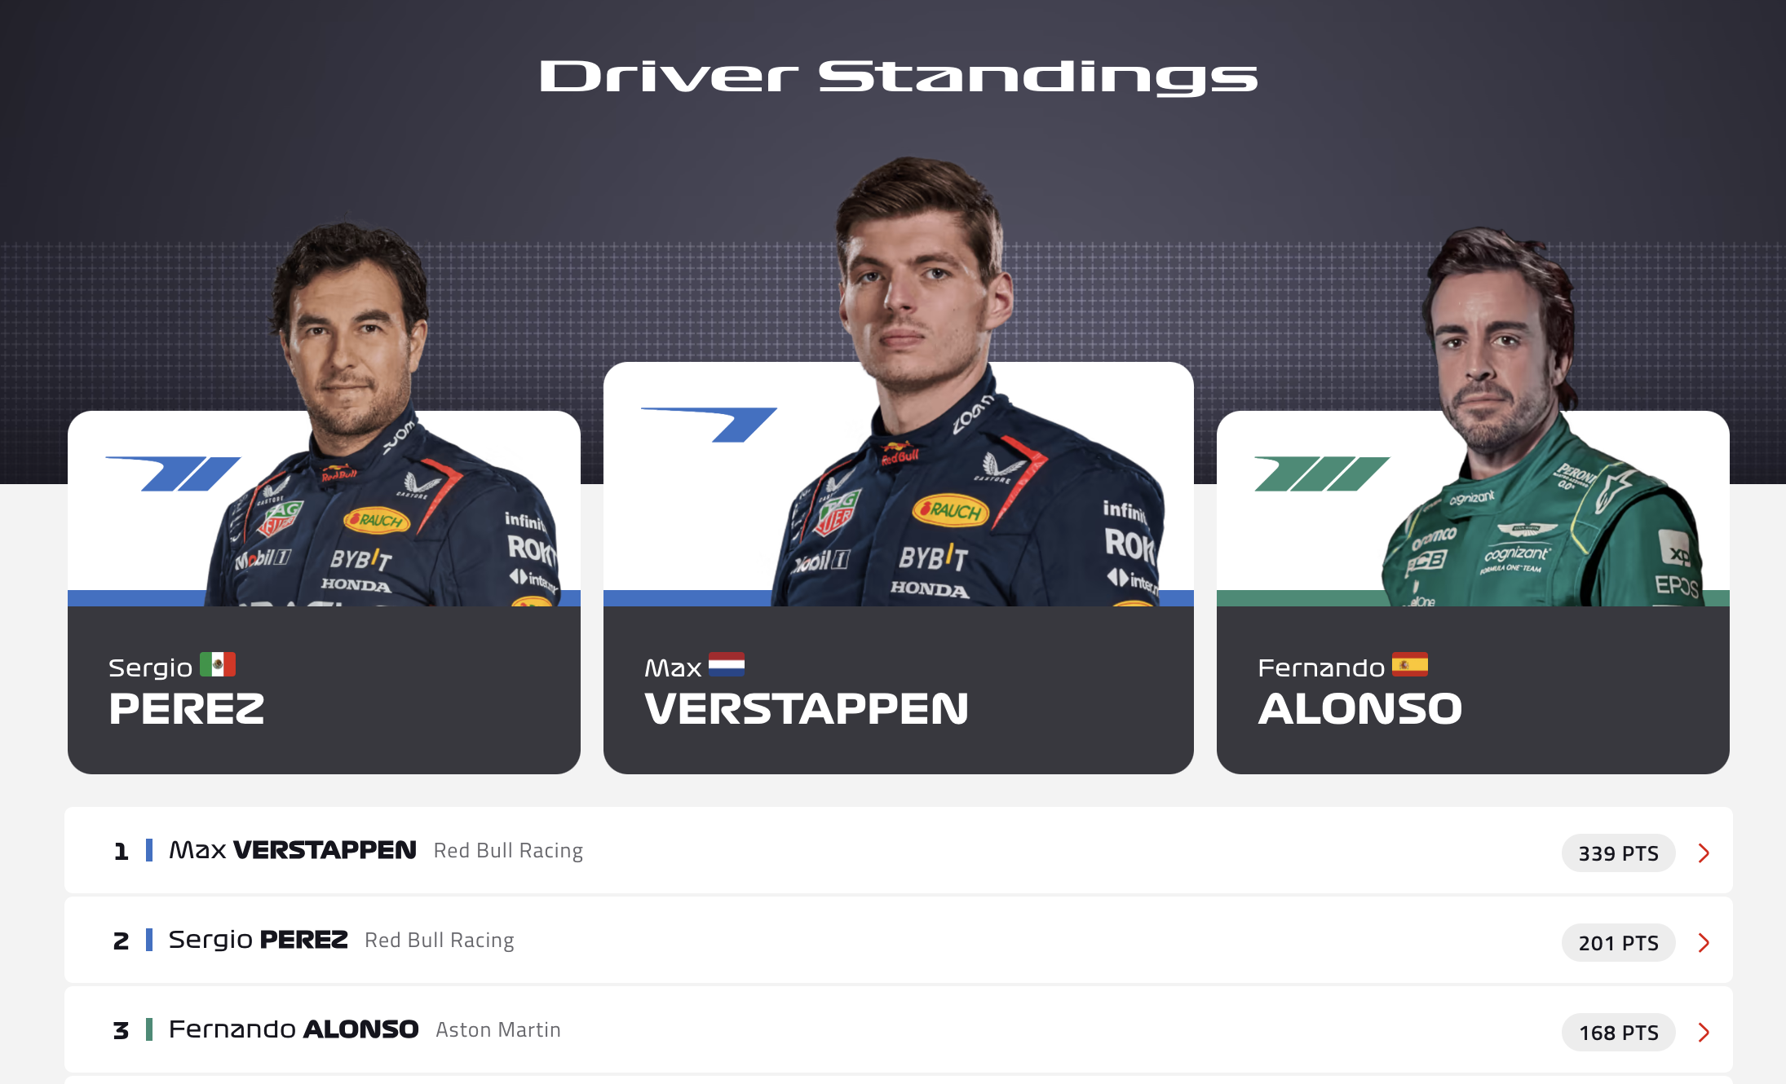
Aims
Find the relationship between each race point between many race factors
Predict each driver’s point of each race

Slide 6
Consumers
Provide drivers with racing strategy
Provide fans with deep and thorough understanding this sport in terms of drivers and constructors

Slide 7
Literature Review
– Academic Paper
A Data-Driven Analysis of Formula 1 Car Races Outcome, 2023, Ankur Patil, Nishtha Jain, Rahul Agrahari, Murhaf Hossari, Fabrizio Orlandi, and Soumyabrata Dev
  Multivariable Linear Regression
  Principal Component Analysis
Formula One Race Analysis Using Machine Learning, 2023, Keertish Kumar, M., Preethi, N.
  Logistic regression
  Decision tree classifier
  Random forest classifier
  Support vector machine
  Gaussian NB
  K neighbor classifier

Slide 8
Literature Review
– Highly Commented Kaggle Notebook
Formula One Pit Stop Analysis https://www.kaggle.com/code/kevinkwan/formula-1-pit-stops-analysis
Formula One Post-Race Summary https://www.kaggle.com/code/jonbown/formula-1-post-race-summary - Constructor-Overall-Standings
Formula One Data Visualizations https://www.kaggle.com/code/ekrembayar/formula-1-70th-anniversary/report

Slide 9
Data Source
– Formula 1 World Championship (1950 - 2023)
https://www.kaggle.com/datasets/rohanrao/formula-1-world-championship-1950-2020/data
There are 14 dataset, 20.63 MB in size.
Data Set | Rows | Columns
circuit | 77 | 9
constructors | 211 | 5
constructor_results | 12290 | 5
constructor_standings | 13051 | 7
drivers | 857 | 9
drivers_standings | 34124 | 7
lap_times | 551742 | 6
Data Set | Rows | Columns
pit_stop | 10089 | 7
qualifying | 9815 | 9
races | 1101 | 18
results | 26080 | 18
seasons | 74 | 2
sprint_results | 180 | 16
status | 139 | 2

Slide 10
R Shiny Demonstration
I published my App to ShinyApps.io as my final product:
https://e2jgp0-liyuan199701.shinyapps.io/F1_Final/
Data Visualizations
Generate new predictions

Slide 11
Final Product
Build a Shiny Dashboard in R on web for publicly displaying prediction and statistics analysis dynamically
Write a report about the explorative data analysis, data cleaning, data transformation, statistical analysis on inference, machine learning on predicting final scores

Slide 12
Potential Audience
The classmates and instructors
Formula 1 racers
Formula 1 constructor teams
Formula 1 third-party sponsors

Slide 13
Data Sources and Obtained
Each Formula one race car has around 300 sensors to collect the real-time 100,000 data from the car and transmit them back to the console center for future car design, improvements, and race strategy.
There are two primary formula 1 data websites that I will use web scrapped techniques on:
https://www.racefans.net/statistics/
https://pitwall.app/
There also is a supplementary F1 dataset via API: https://ergast.com/mrd/

Slide 14
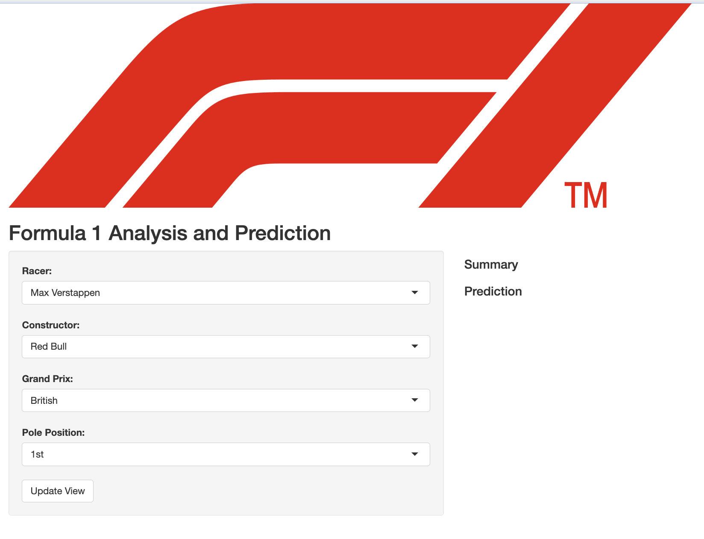
Mock-up the Final Product
A final looks like a simple user-friendly Shiny Web App publicly like below hand-written

Slide 15
Thanks for listening!
Go Racing!
Repeated measurements

Slide 16
Project Check-in: Visualization
Léon Yuan
Sep 27th, 2023

Slide 17
Source the data
https://www.racefans.net/statistics/
Use web scrape in R to grab all data from Season 2012 to Season 2018
The data before Season 2011 is incomplete and inconsistent with the data after Season 2011, some old Season data only have graphs instead of numeric values
To keep my analytics and modeling manageable and doable on time, I grabbed all data from Season from 2012 to Season 2018
After grabbing all data, I spent much time cleaning data and transforming and joining data

Slide 18
Plot Types with all Plotly
Time Series data for championship scores of drivers and teams
Driver Radar Plot
Correlation graphs between major factors
Violin and Boxplot for scores
Random Forest Variable Importance

Slide 19
Summarize project goal
Predict the race score
Find performance changes by each driver
Find the most influenced factors to scores
Find individual variation and team variation

Slide 20
End-User and Why
1. Provide racing strategy to drivers (Useful to help them win)
2. Help Car Manufacturer improve the car performance
3. Provide the fans with gambling strategy to win

Slide 21
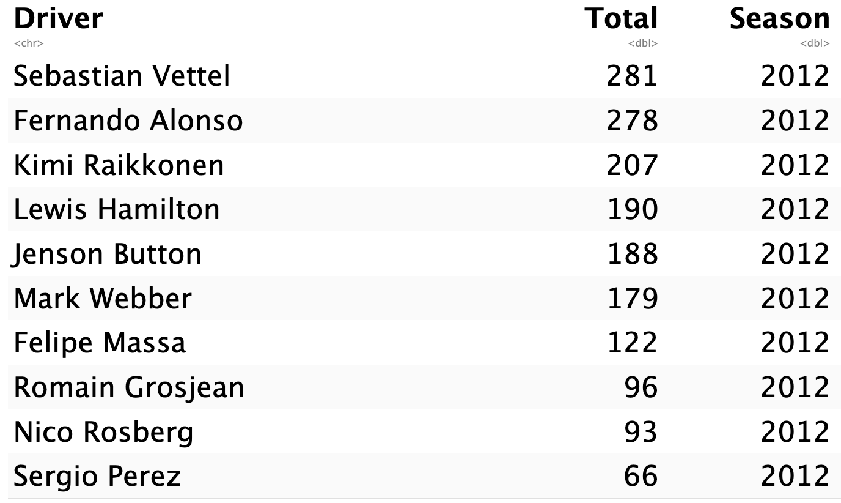
Summary of Data
There are 7 dataset instead of one, I am going to do analysis on some of them.
The most important three dataset are Driver-Season-Score;
There are 159 rows and 3 columns.

Slide 22
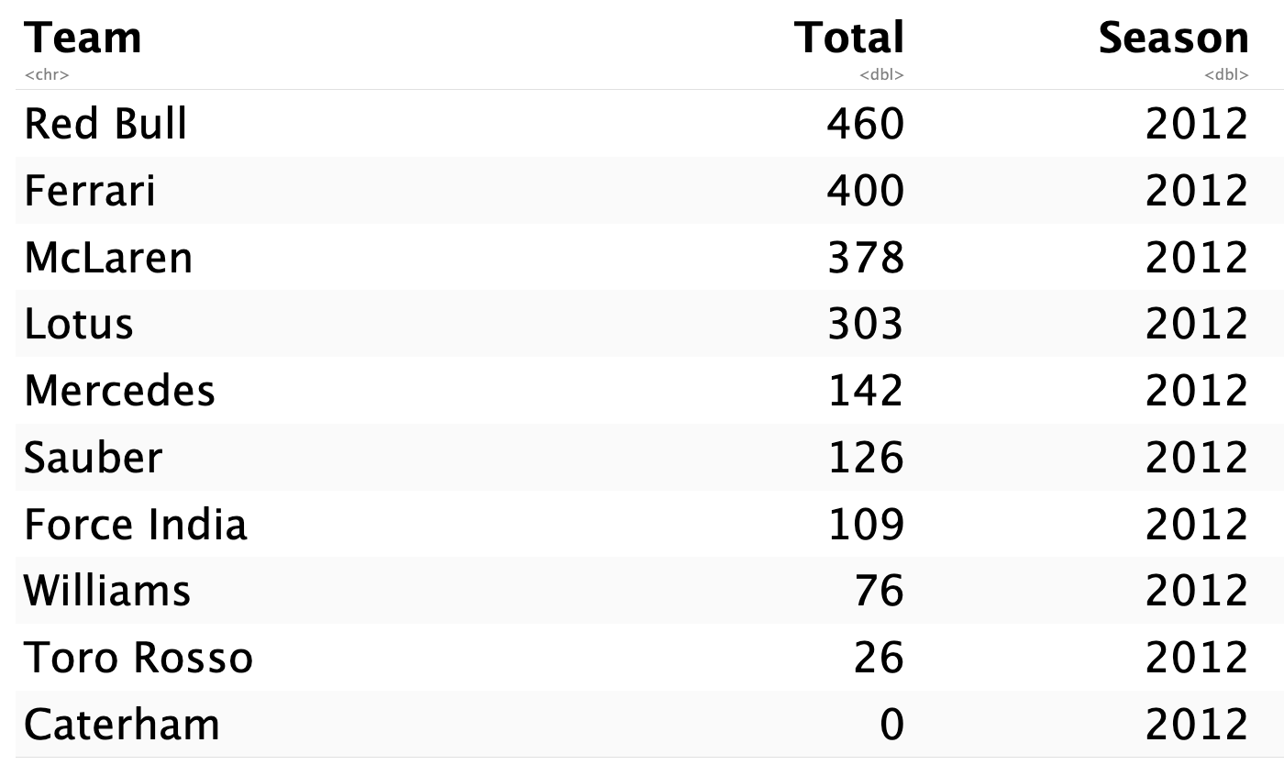
Summary of Data
3. Team-Season-Score
There are 75 rows and 3 columns.

Slide 23
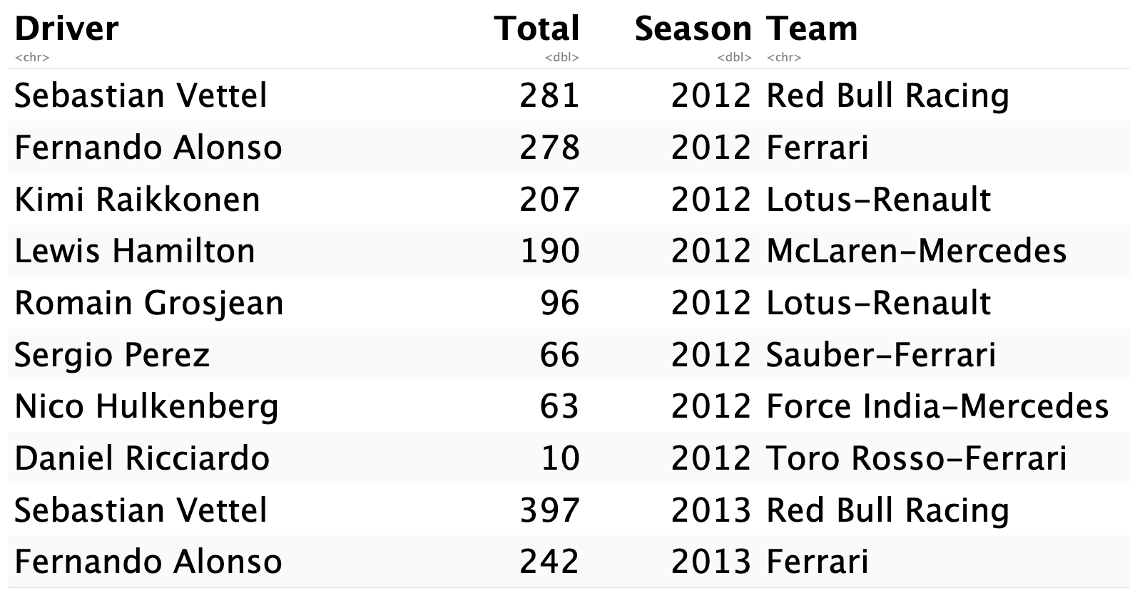
Summary of Data
4. Driver-Season-Team-Score
There 56 rows and 4 columns

Slide 24
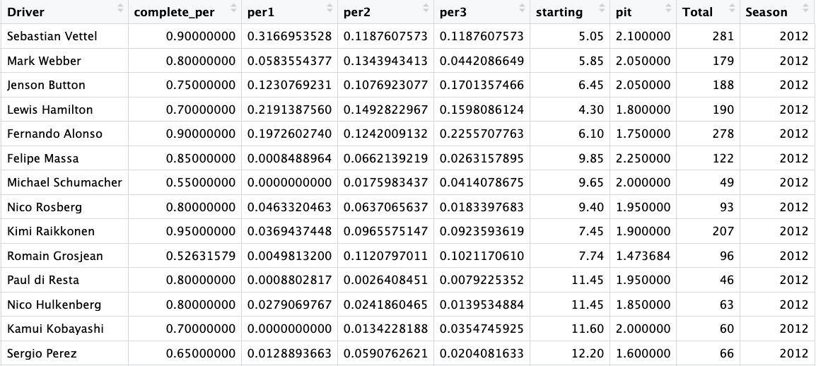
Summary of Data
5. Factors and Total Score dataset
There 159 rows and 9 columns

Slide 25
Pre-Processing
– Data Cleaning
After web-scraping data, make sure the scraped dataset is consistent with data shown on the websites
Rename the column names
Recalibrate the column names
The scraped dataset is scattered around the websites, find the key variables to join them

Slide 26
Pre-Processing
– Feature Selection
For Driver-Season-Team-Score dataset, find which teams each driver belongs to and inner join them
According to the existing paper I found at the beginning of this project, PCA was used to reduce the dimensionalities of a large number of factors.
Pit.Stop, Tire Type usage, 1st, 2nd , 3rd position of laps, complete laps, starting position
Remove Tire Type factor because of inconsistent records from webs

Slide 27
Pre-Processing
– Feature Engineering
Aggregate all Grand Prix game levels into Seasonal levels
Calculate the percentage of complete laps for each driver
Calculate the percentage of 1st, 2nd, 3rd positions of laps for each
Calculate the average starting positions for each driver
Calculate the average Pit Stop time for each driver
Concatenate each seasonal data into one data frame

Slide 28
Pre-Processing
– Tidymodels
Center all numeric predictors
Scale all numeric predictors
Dummy the categorical predictor such as Team and Season

Slide 29
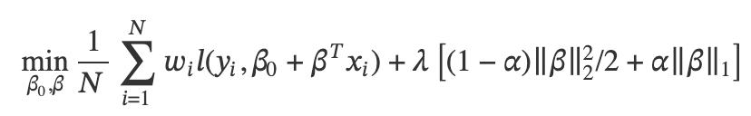
Summary of base model
– Penalized Linear Regression
Tidymodels glmnet tunes penalty and mixture parameters
5-fold 2 repeated cross validation resamples
5 sizes of tuning parameter combinations
Predict the Total Score for each driver
The best RMSE is 21.17231 with penalty = 1.1e(-6) and mixture = 0.15

Slide 30
Summary of base model
– Random Forest Regression
Tidymodels tunes the two parameters: number of predictors and min of observations in a node given 50 trees
5-fold 2 repeated cross validation resamples
10 sizes of tuning parameter combinations
RMSE is chosen to be metric
The best RMSE is 25.54 with mtry = 5 and min_n = 10

Slide 31
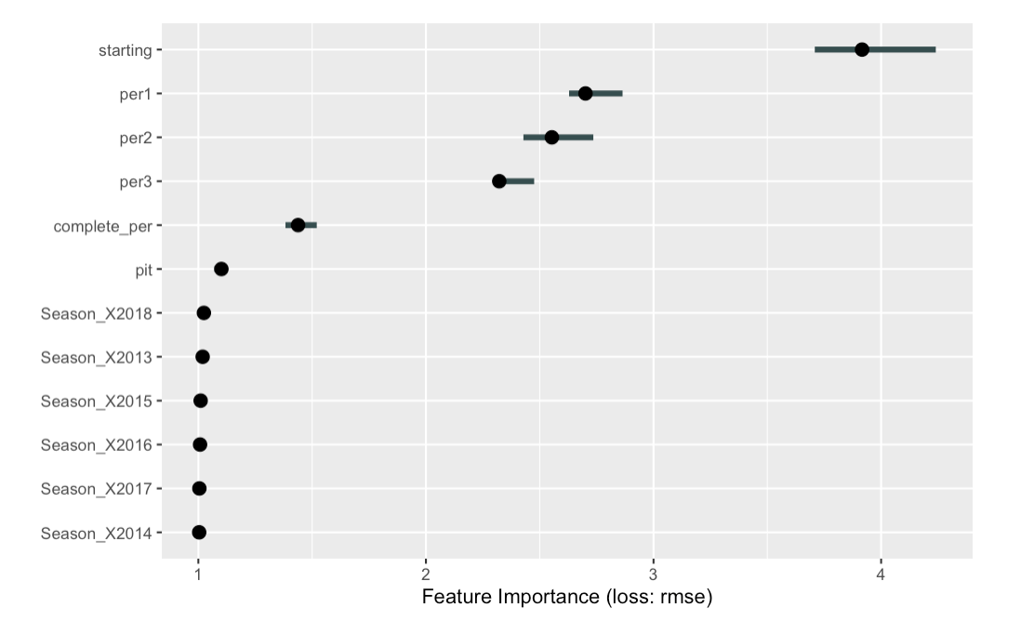
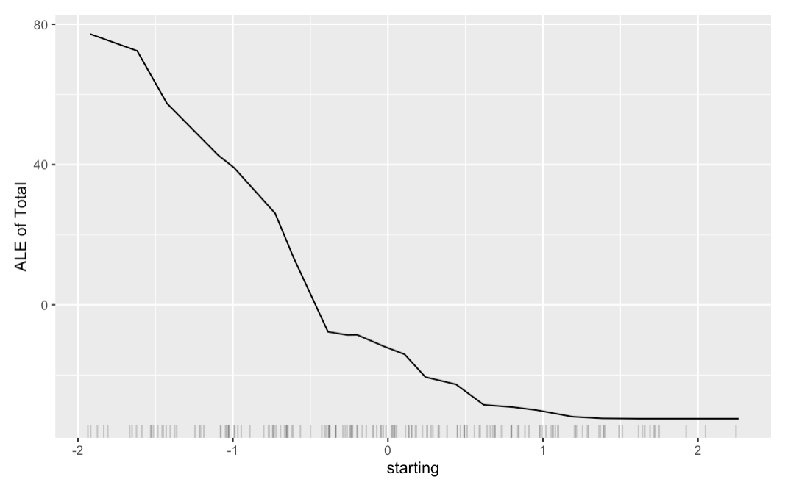
Summary of base model
– Variable Importance
Starting factors is the most influential variable; As the average start position increases, the final score decreases a lot.

Slide 32
How end-users use them
The penalized linear regression model is selected to predict the final score given all the predictors. (This is retrospective model)
The random forest model is to interpret which factors and how much they influence the final results.
The next repeated measurement models also help end-users to explain the within subject variation and some random/fixed effects.

Slide 33
Other models
– Linear Mixed Model
This is a repeated measurement analysis instead of machine learning
  Flexibly describes the heterogeneity between each driver
  Hold the correlation within each driver
  Allow the different variance-covariance matrix design
$${Total}_{ij}= {Team}_{i}+ {Season}_{ij}+ {Season}_{ij}×{Team}_{i}+E_{ij} | {Driver}_{i}$$
1. Team is random effect
2. Season is time index and fixed effect
3. Driver is subject level

Slide 34
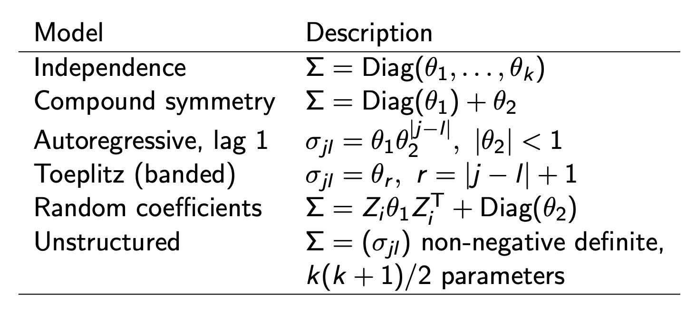
Other models
–Linear Mixed Model
– Possible Variance Matrix
Notes from STAT 7331

Slide 35
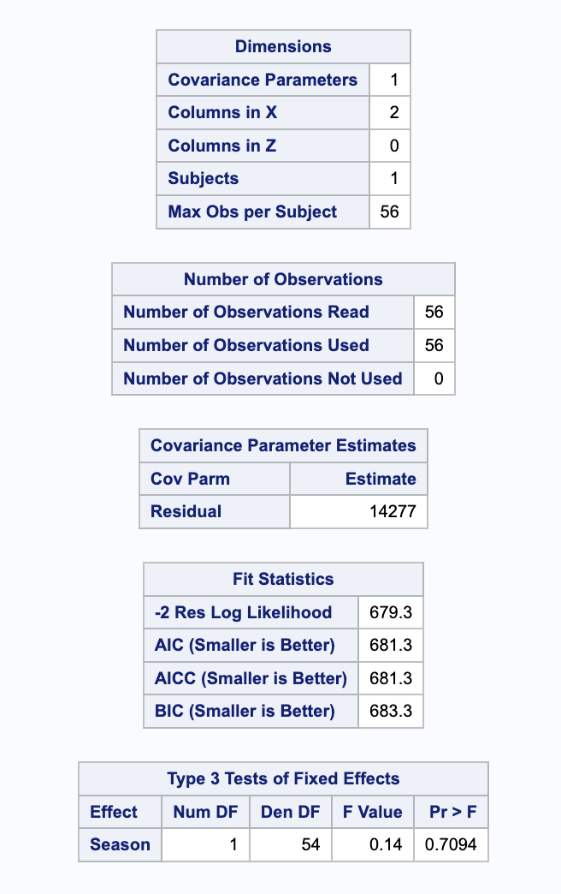
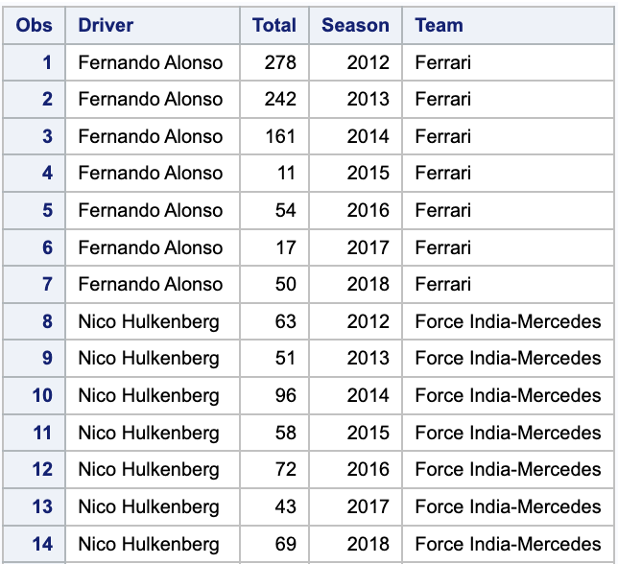
Other Models
– Linear Mixed Models
Independence Variance Matrix

Slide 36
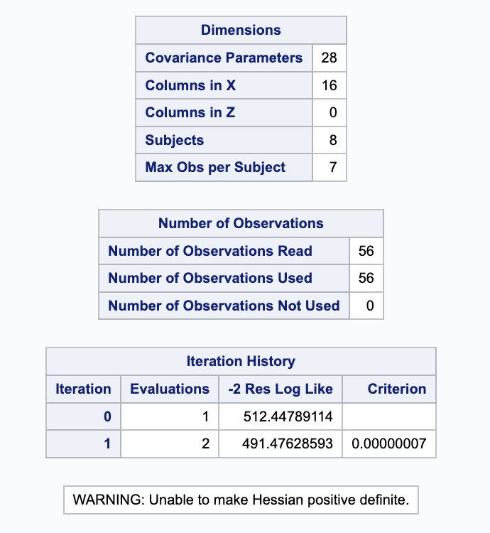
Other Models
– Linear Mixed Models
Unstructured Correlation

Slide 37
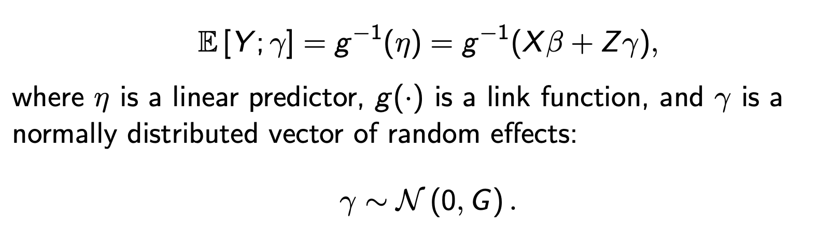
Other Models
– Generalized Linear Mixed Models
Notes from STAT 7331
1. Allow more response distribution in addition to normal distribution while hold all other flexible properties

Slide 38
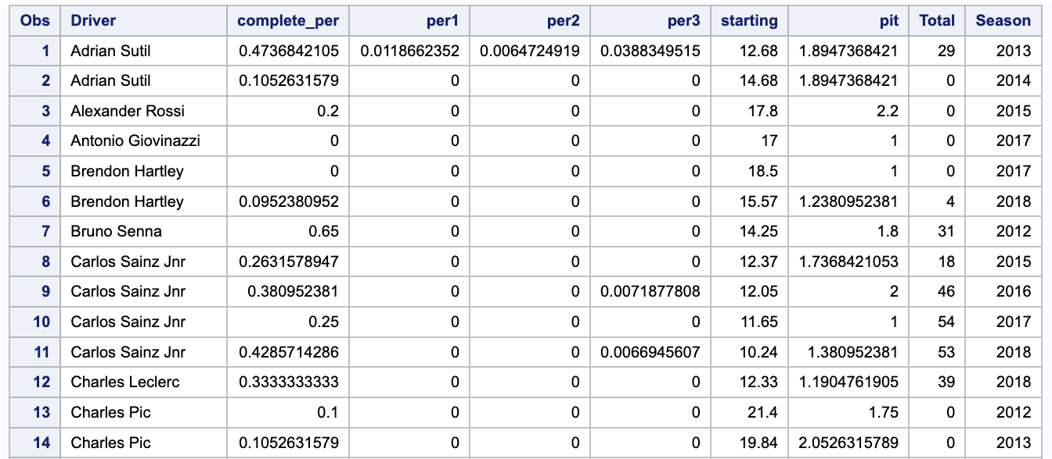
Other Models
– Generalized Linear Mixed Models

Slide 39
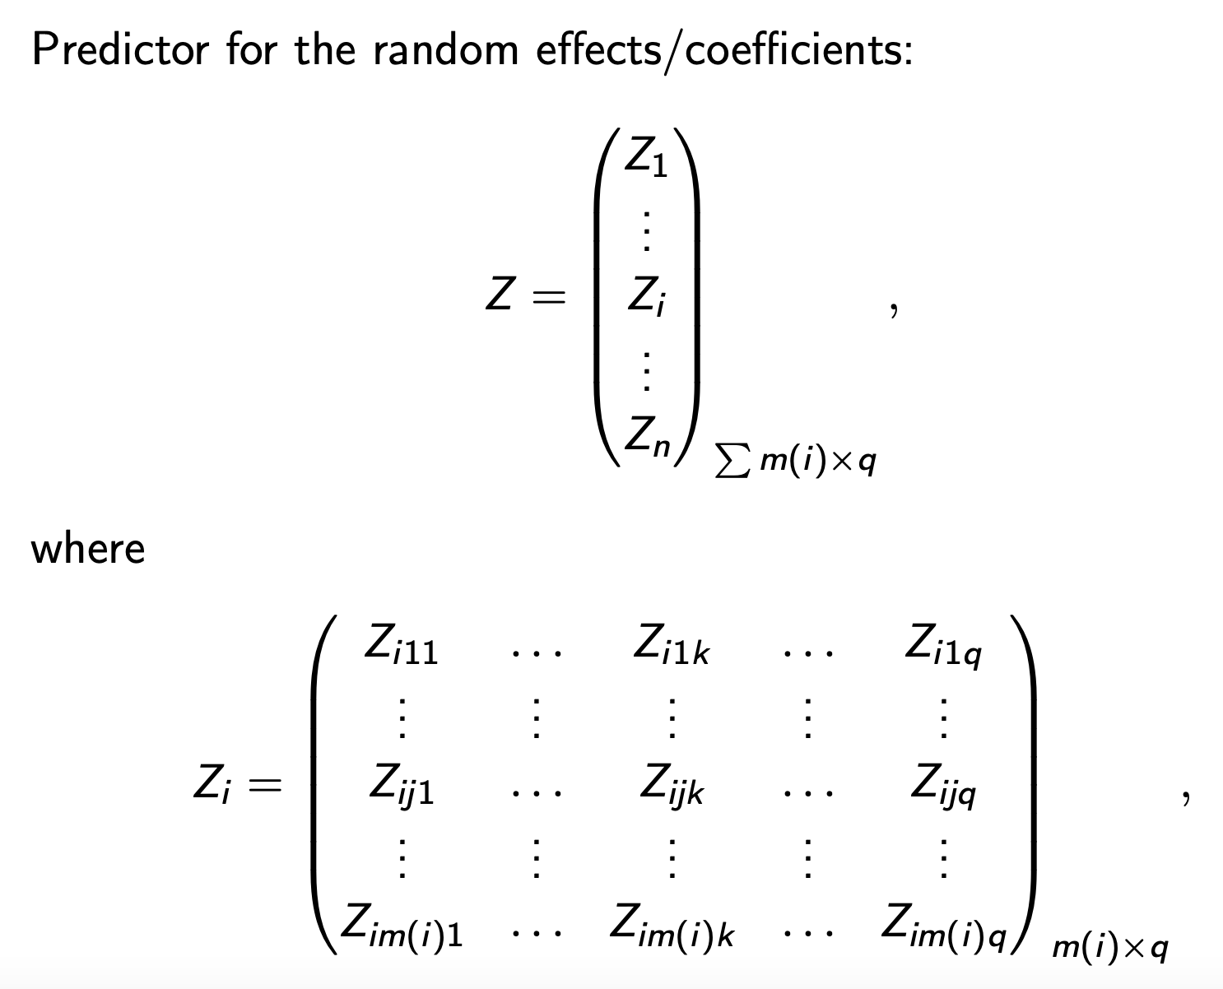
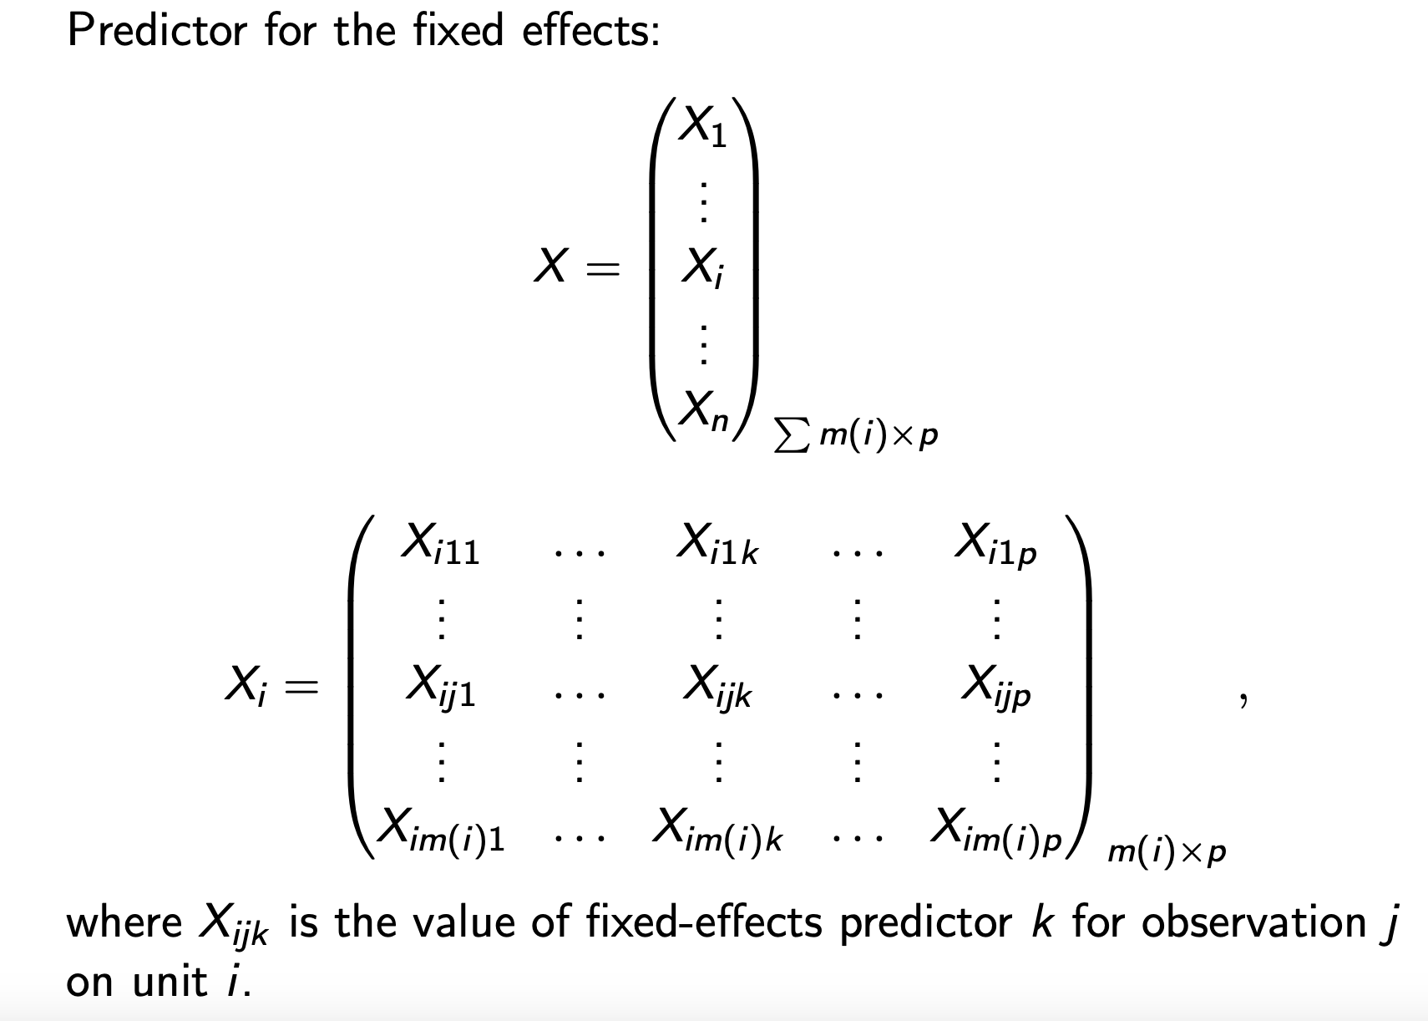
Other Models
– Generalized Linear Mixed Models
Notes from STAT 7331

Slide 40
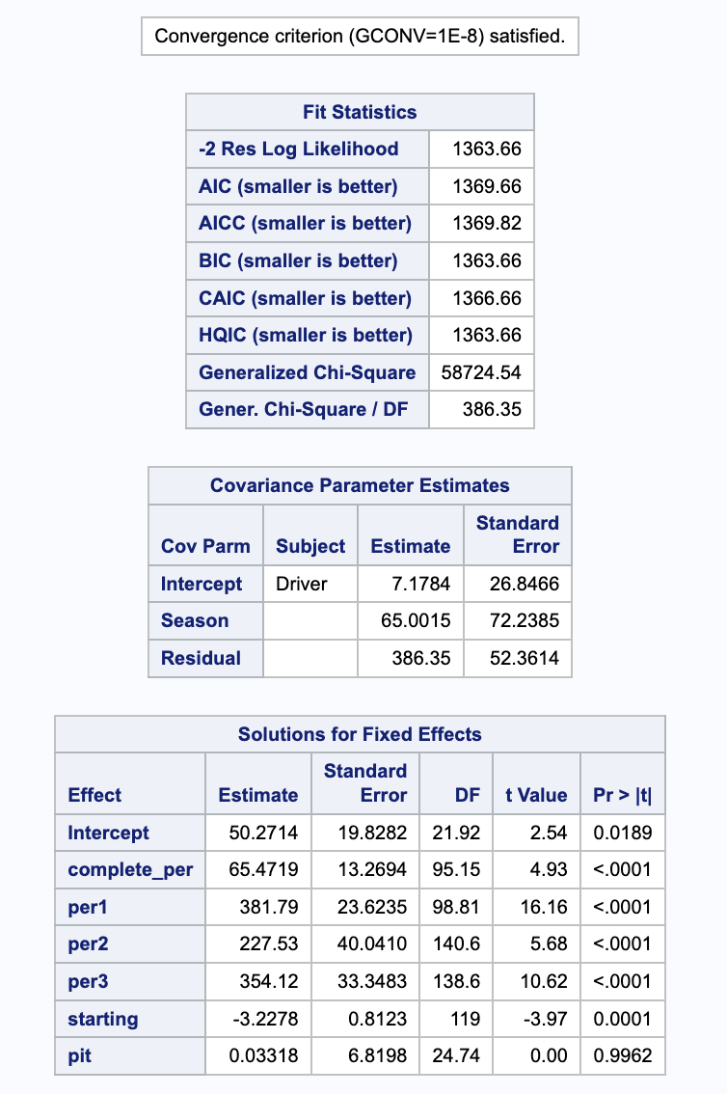
Other Models
– Generalized Linear Mixed Models
Convergence Criterion satisfied.

Slide 41
Unanticipated problems
My dataset is so small because there are very limited published dataset about Formula One
This small dataset gives rise to difficulty of modeling regardless machine learning or traditional statistical modeling
There is no structured and cleaned dataset.
Featuring Selection and Featuring engineering can be subjective and result in very different findings
The generalization of machine learning modeling is poor
There are some drivers dropping out and new drivers coming in. Even if using repeated measurements, it is biased and unstable for modeling.

Slide 42
Bayesian Linear Mixed Model
Bayesian Models allow us to calculate it without specifying null hypothesis in advance.
If Bayesian models perform well, the posterior inference generally is more accurate and gives better measurement of uncertainty.
There are some factors that should be modeled as fixed effects, and some should be random effects.
To simplify computational parts, I assumed linear relationships between factors and outcomes.
The outcome is assumed to have a normal distribution.

Slide 43
Bayesian Linear Mixed Model
– predictors and the outcome
Predictor | Effects
Year | Fixed
Circuit | Fixed
Age | Fixed
Qualify | Fixed
Constructor | Random
Driver | Random Nested Within Constructor
Points | Outcome

Slide 44



Bayesian Linear Mixed Model
– Statistical Formula
$$Points_{i}=β_{0}+β_{1}⋅Year_{i}+β_{2}⋅Circuit_{i}+β_{3}⋅Qualify_{i}+β_{4}⋅Age+ γ⋅Constructor_{i}+η⋅Driver:Constructor+ε_{i}$$
Prior Distribution for all parameters:
$$\left(β_{0},β_{1},β_{2},β_{3},β_{4}\right)∼N(0, (2.5, 2.5, 2.5, 2.5, 2.5))$$
$$γ∼N\left(0, 1\right), η∼N(0, 1)$$
$$ε∼N\left(0, σ^{2}\right) where σ∼N(0, 1)$$

Slide 45
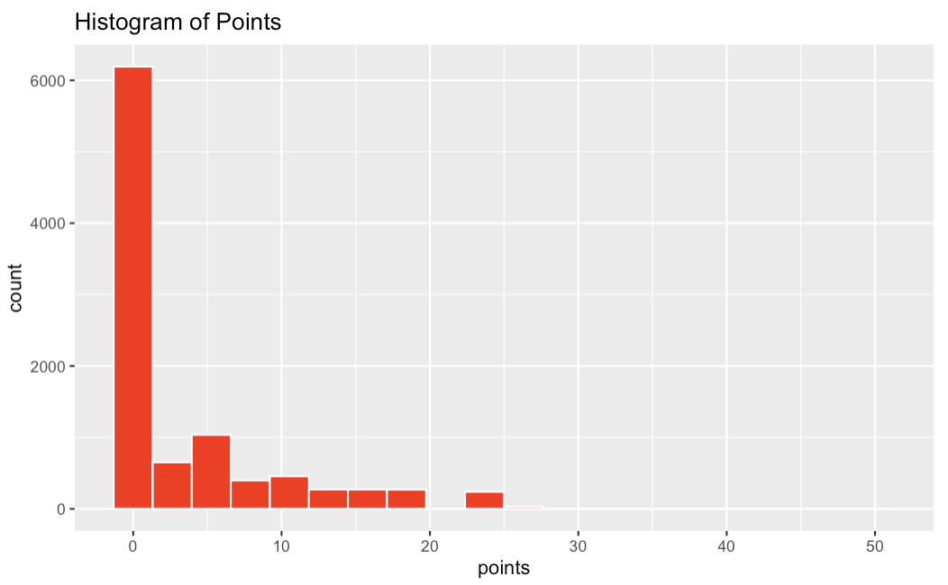
Bayesian Linear Mixed Model
– modeling data
The modeling data has 9,815 rows and 8 columns.
It includes seasonal year from 1994 to 2023.
It has 168 drivers, 46 constructors, and 42 circuits.
Year | Circuit Id | Driver Id | Constructor Id | Qualify | Age | Driver-Constructor | Points
1994 | 18 | 30 | 22 | 2 | 25.2 | 30.22 | 10
2010 | 3 | 4 | 6 | 3 | 28.6 | 4.6 | 25
2023 | 77 | 852 | 213 | 16 | 22.8 | 852.213 | 0

Slide 46
Bayesian Linear Mixed Model
– Build Rstan Model
I used my local computer to build because Maneframe failed to last.
I used 24 cores.
3,000 iterations with
8 Chains
Each chain has 1,500 warmup; In total 12,000 post-warmup samples
It takes 28 mins to finish thankful to parallel cores

Slide 47
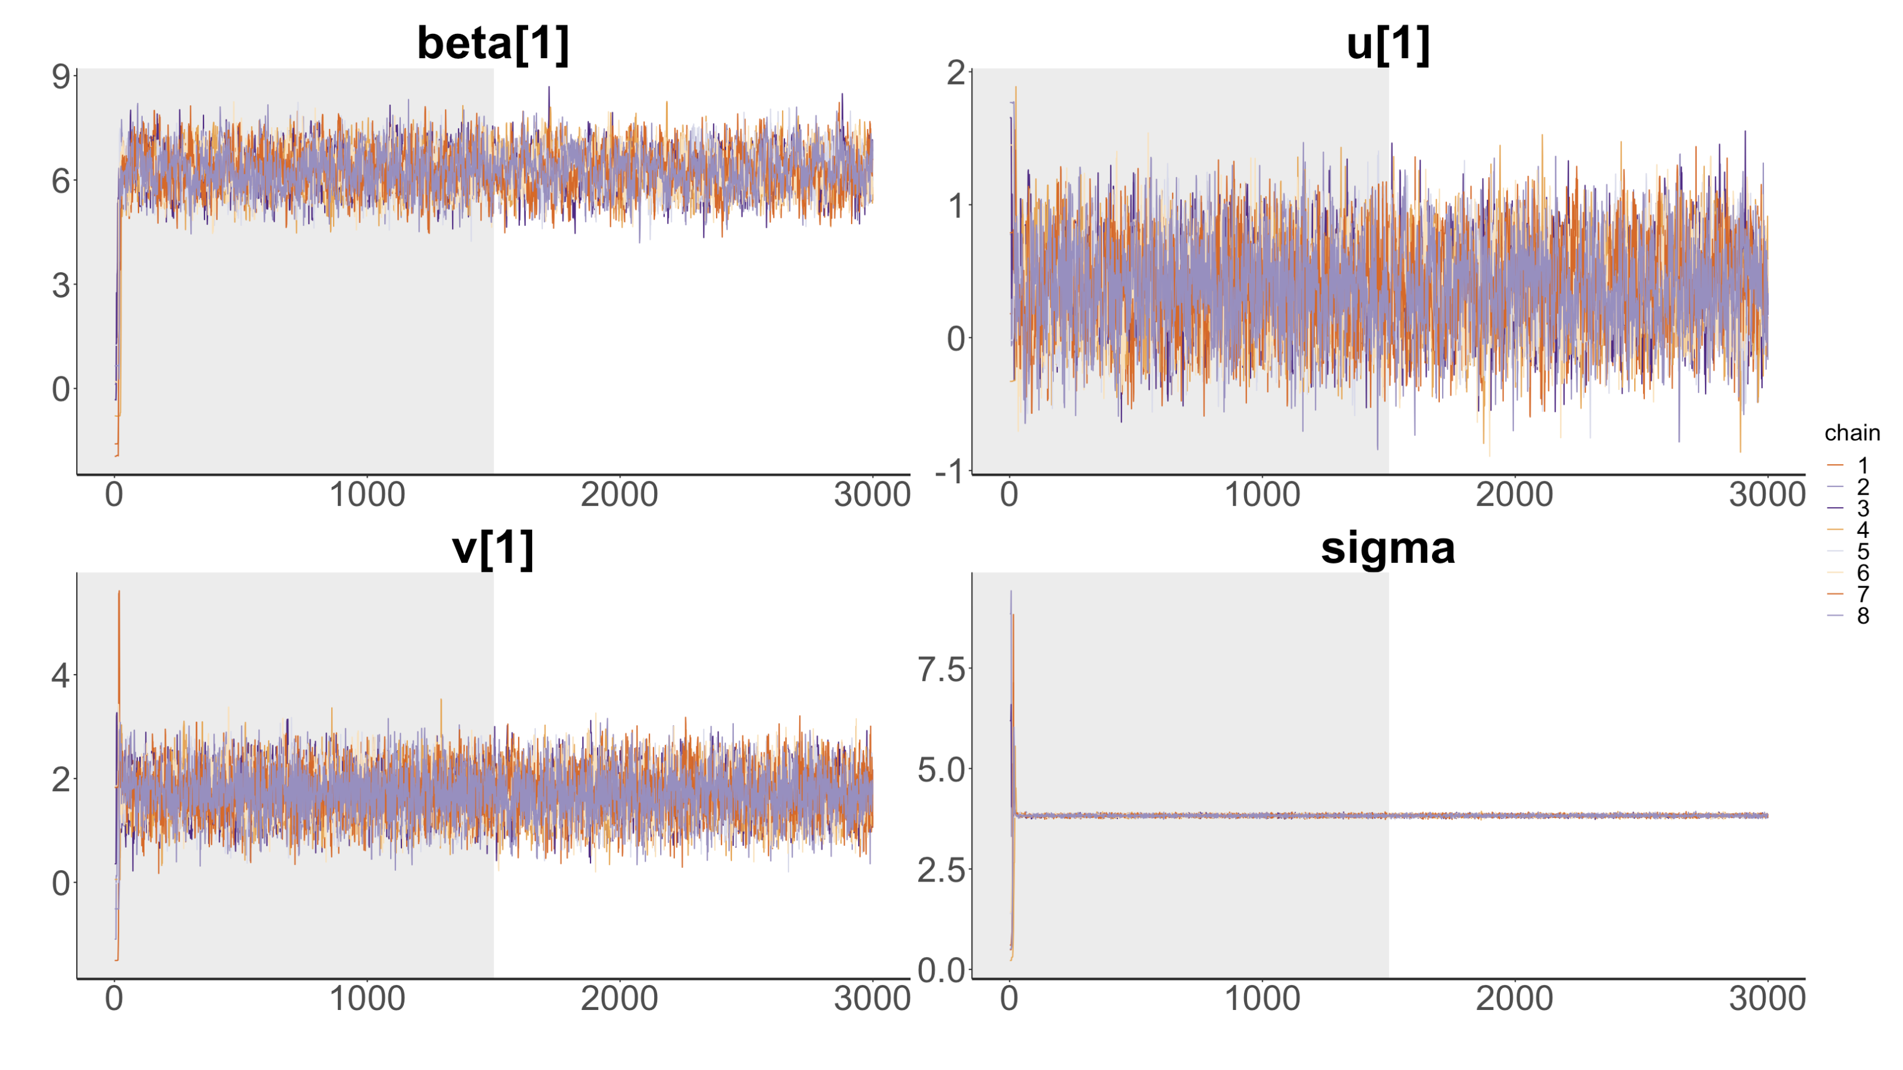

Bayesian Linear Mixed Model
– Model Diagnostics
I selected $β_{1}$, $u_{1}$, $v_{1}$, $σ$ to show their trace plot because of page limit.
The convergence for all is pretty healthy, there is no divergent trend.

Slide 48
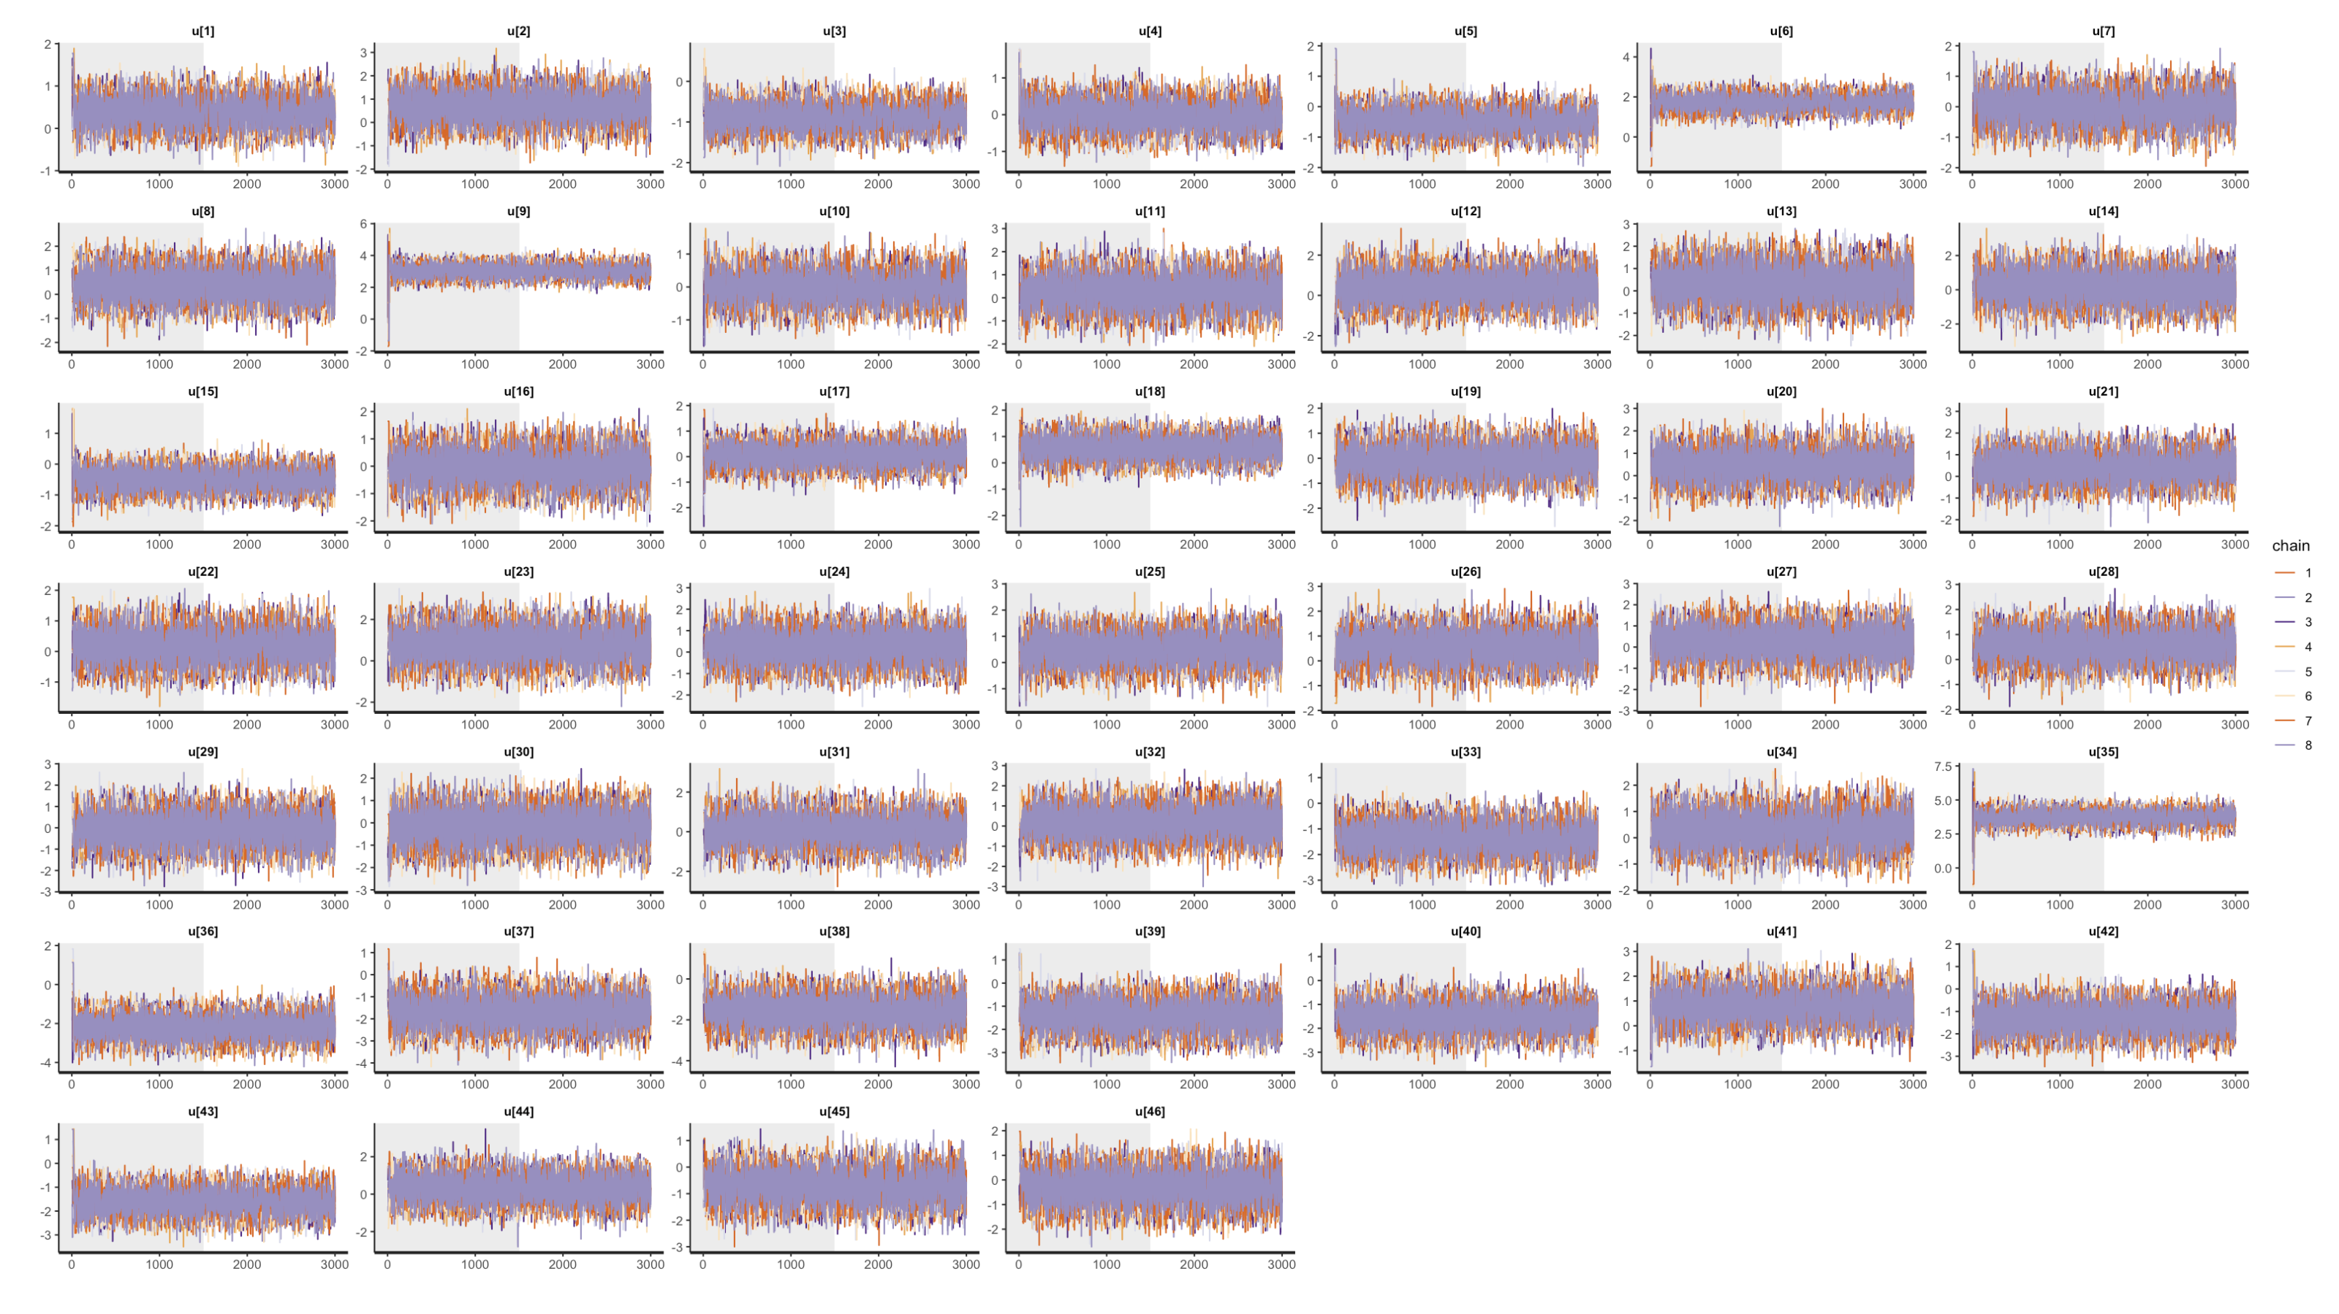
Bayesian Linear Mixed Model
– Model Diagnostics
Trace plots of all coefficients for random effect constructors

Slide 49
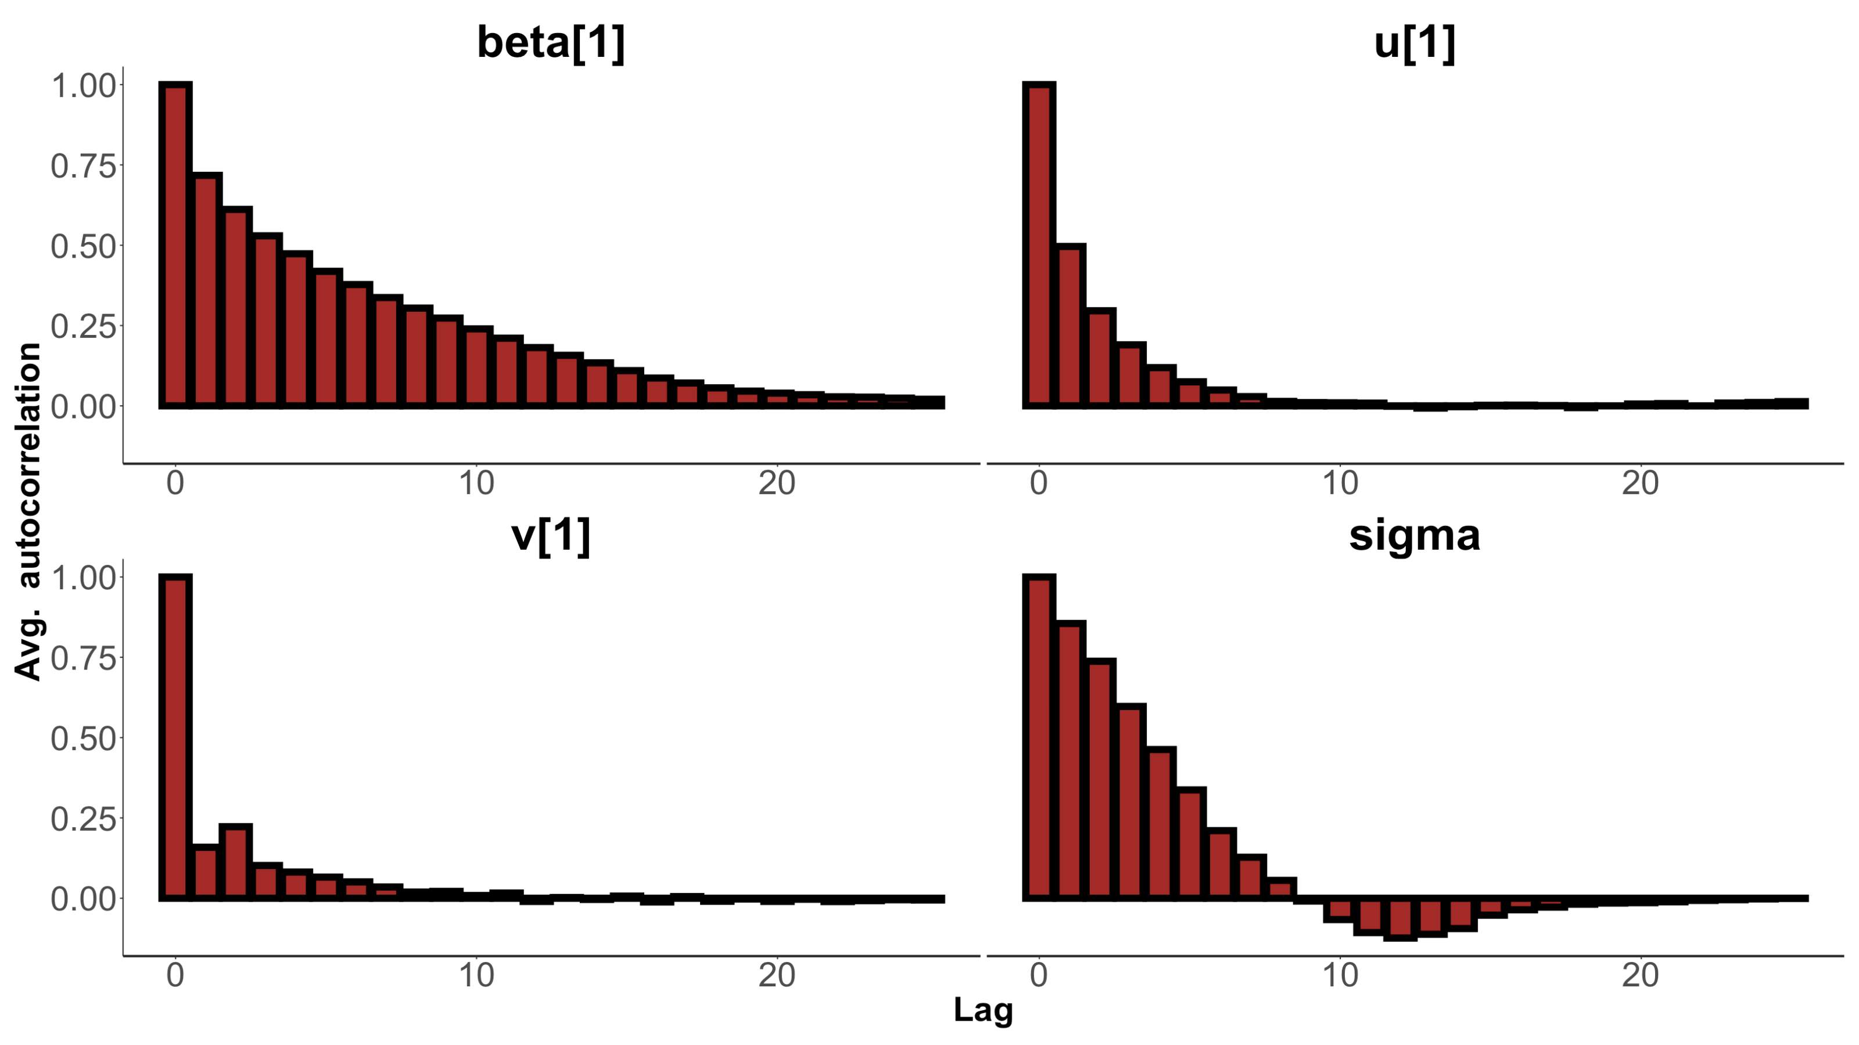
Bayesian Linear Mixed Model
– Model Diagnostics
Autocorrelation plots for posterior draws of $β_{1}$, $u_{1}$, $v_{1}$, $σ$.

Slide 50
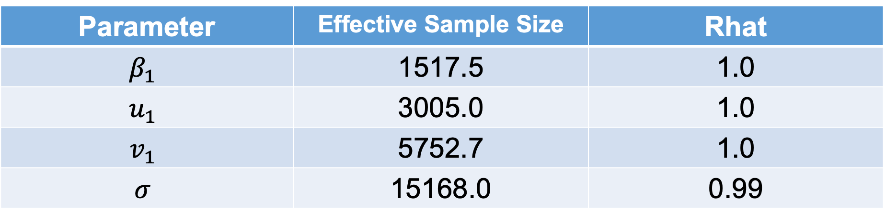
Bayesian Linear Mixed Model
– Model Diagnostics
Let us check these parameters’ Rhat and ESS as follows:
Parameter | Effective Sample Size | Rhat
$$β_{1}$$ | 1517.5 | 1.0
$$u_{1}$$ | 3005.0 | 1.0
$$v_{1}$$ | 5752.7 | 1.0
$$σ$$ | 15168.0 | 0.99

Slide 51
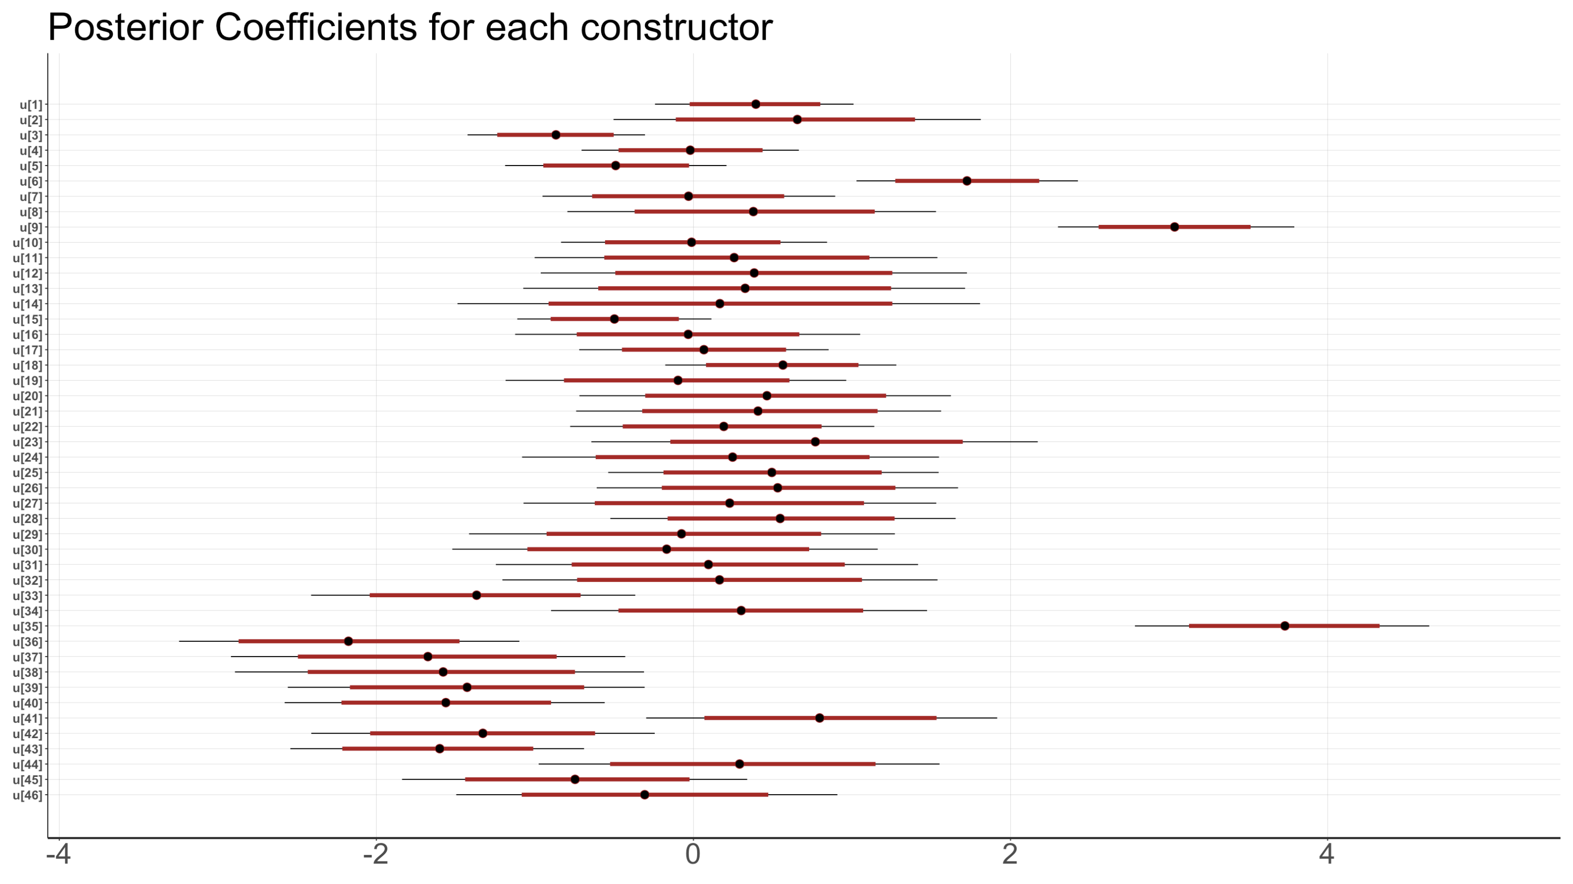
Bayesian Linear Mixed Model
– Posterior Coefficients for constructors
1st is German Mercedes, 2nd is Austrian Red Bull, 3rd is Italian Ferrari
The last one is Spanish HRT Formula 1 Team.

Slide 52


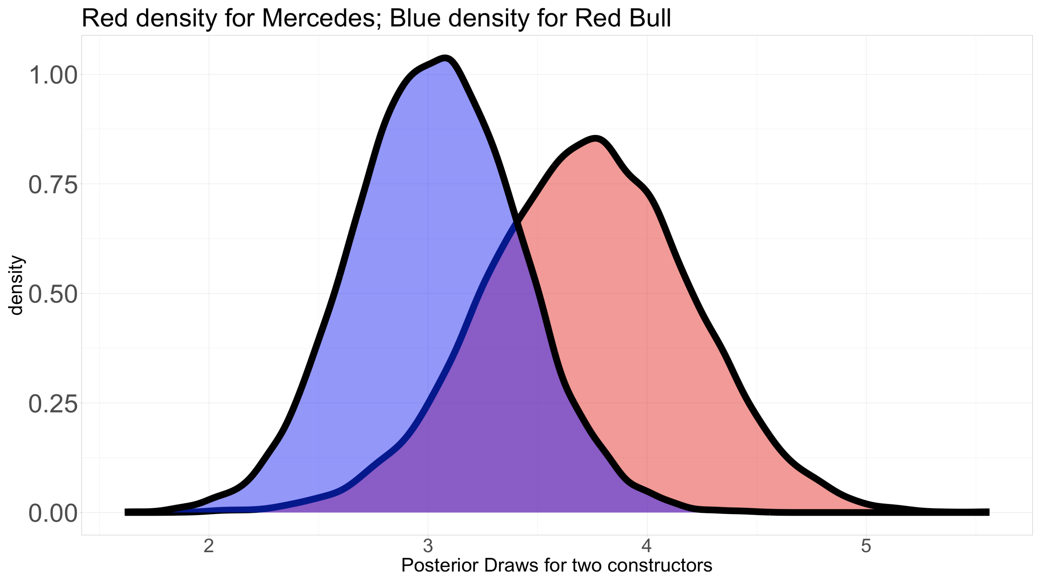
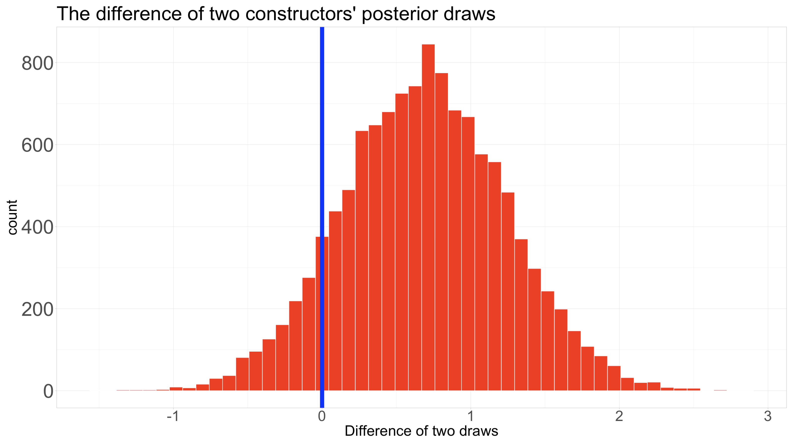
Bayesian Linear Mixed Model
– Posterior Coefficients for constructors
Let’s further compare Mercedes and Red Bull
Calculate the difference between two constructors’ posterior draws.
The highest density interval is [−0.39, 1.77].
We have 89.4% confidence that Mercedes performs better than Red Bull.

Slide 53
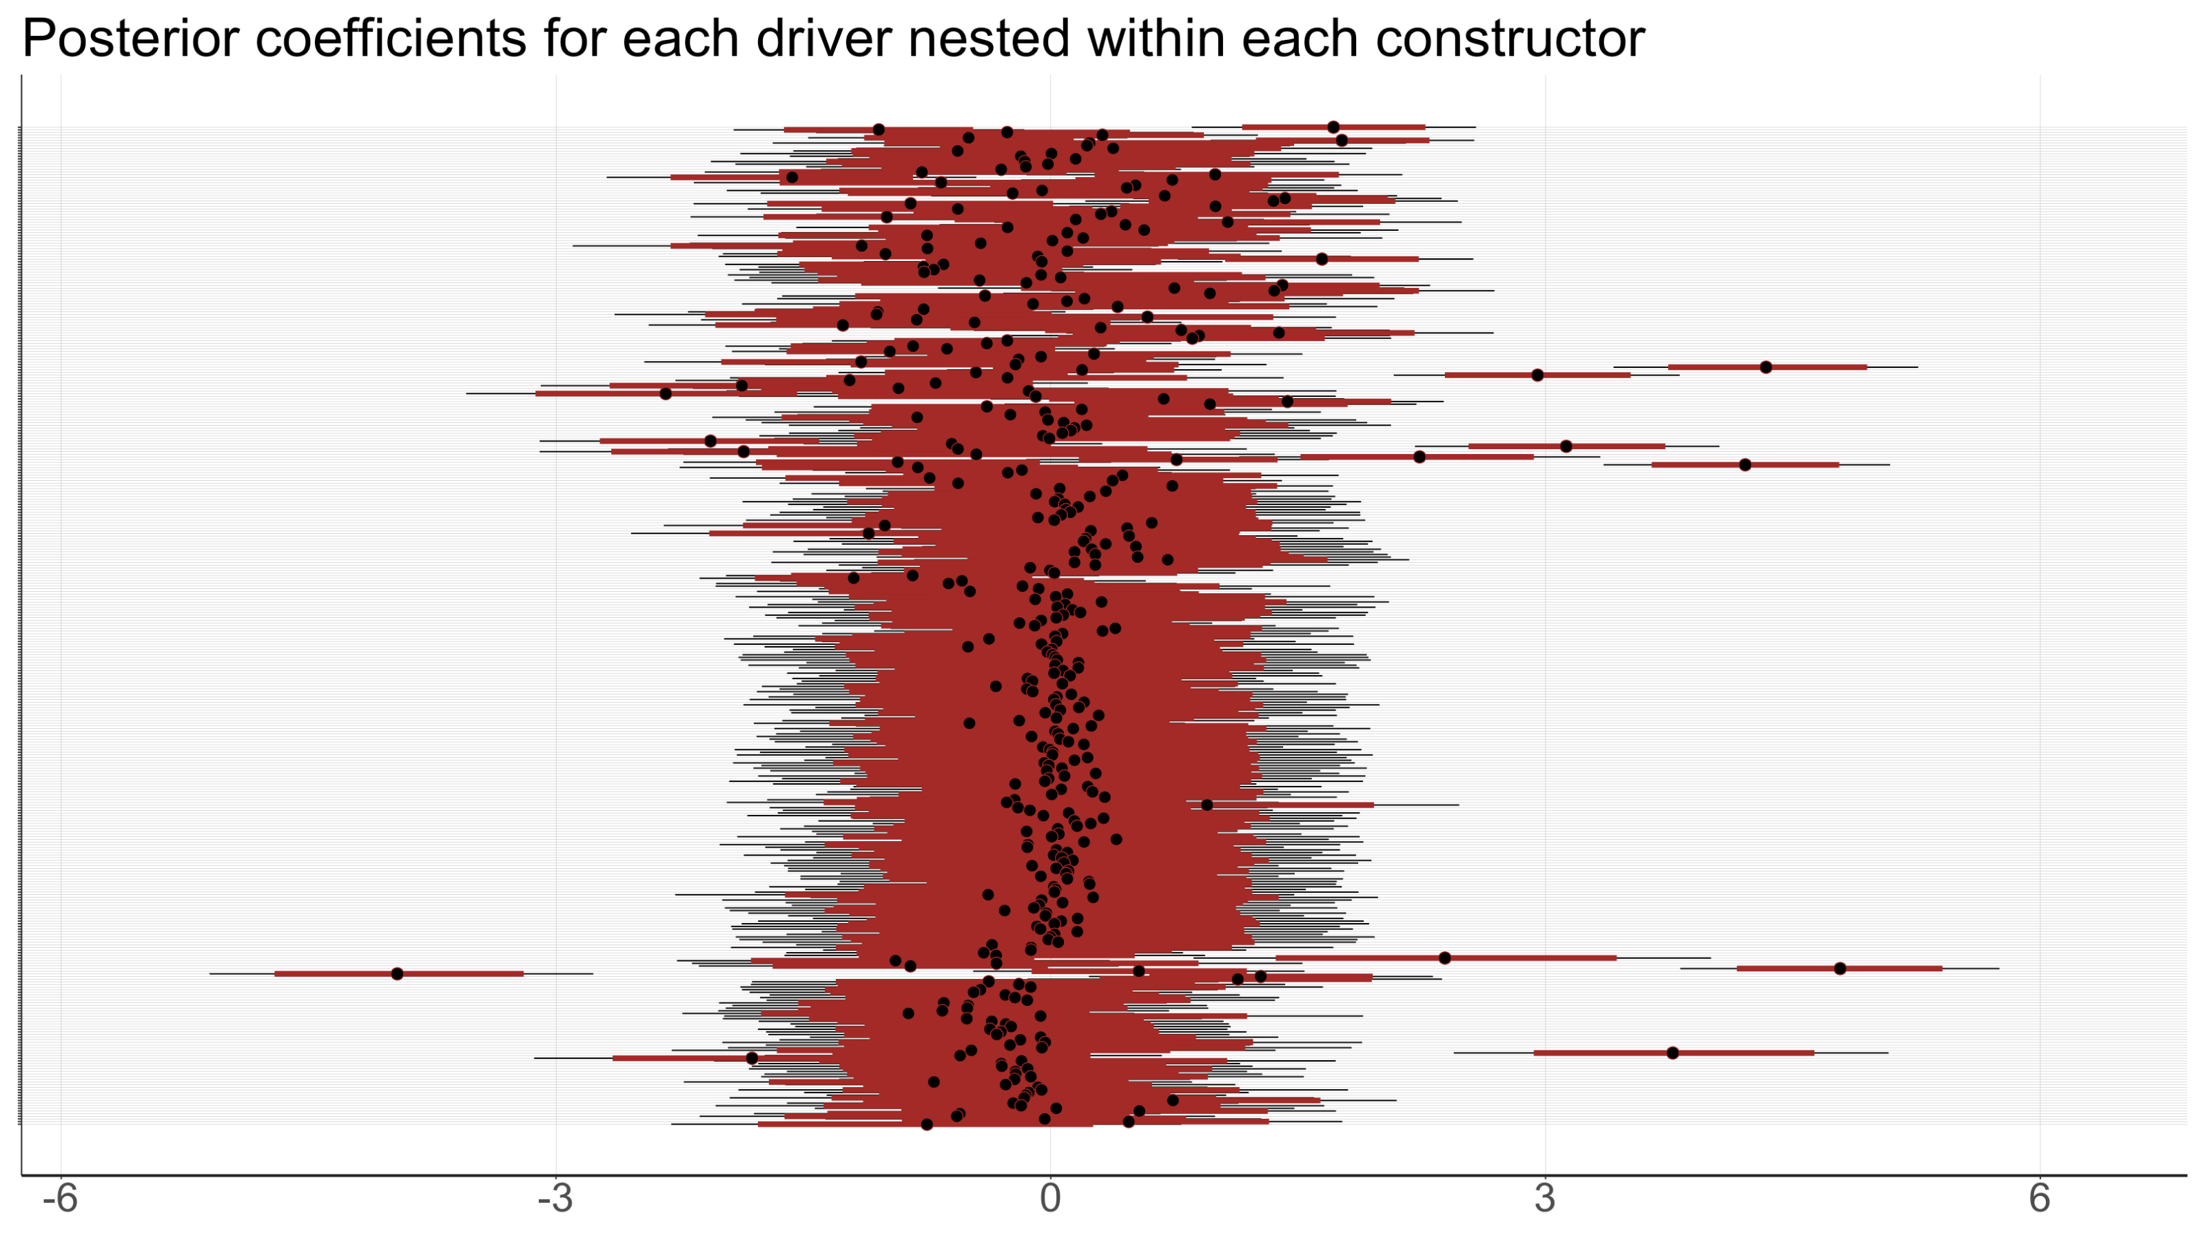
Bayesian Linear Mixed Model
– Posterior Inference for drivers
Fernando Alonso from Ferrari
Lewis Hamilton from Mercedes

Slide 54
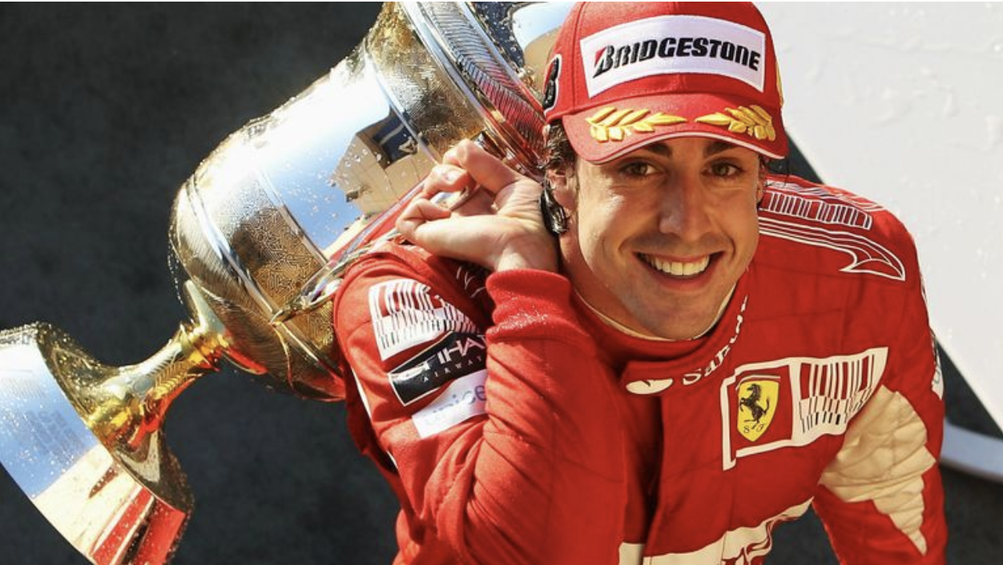
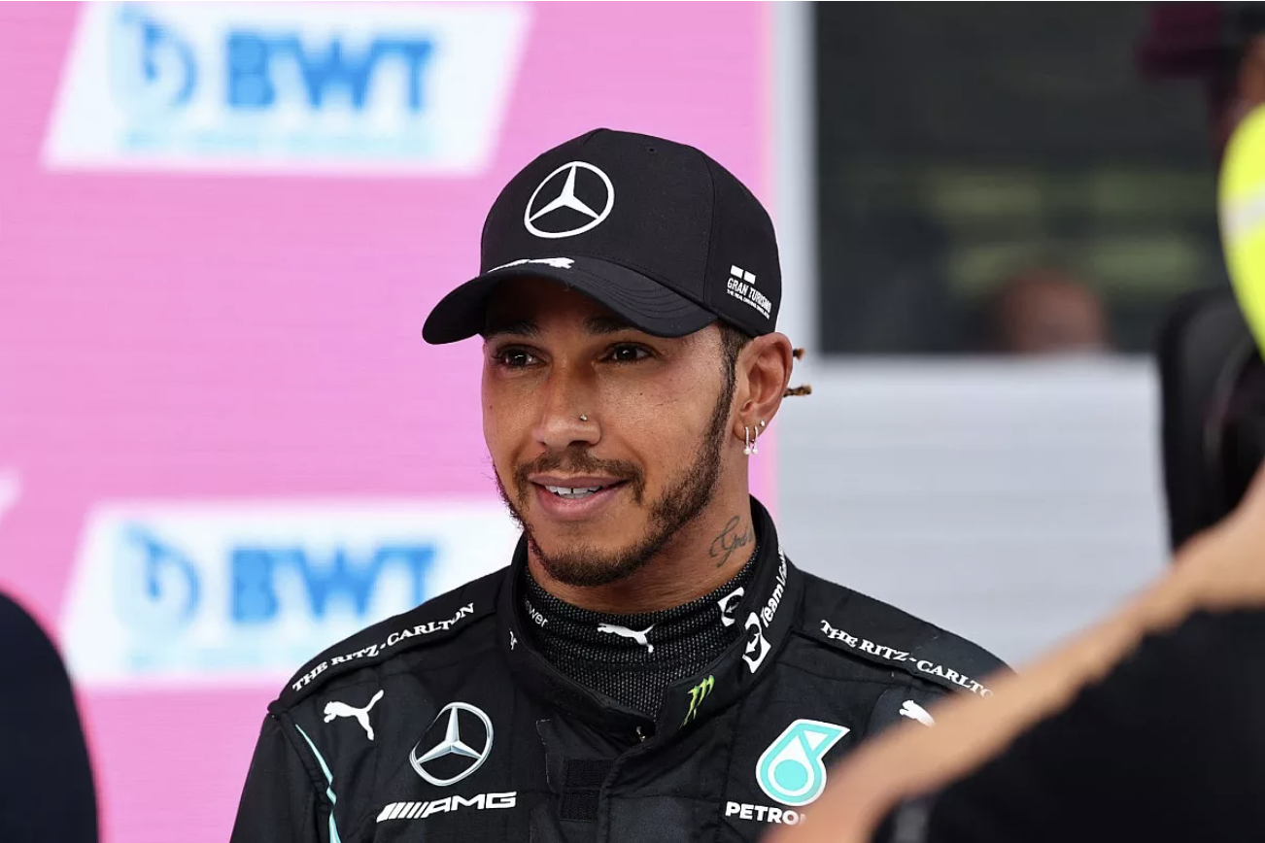
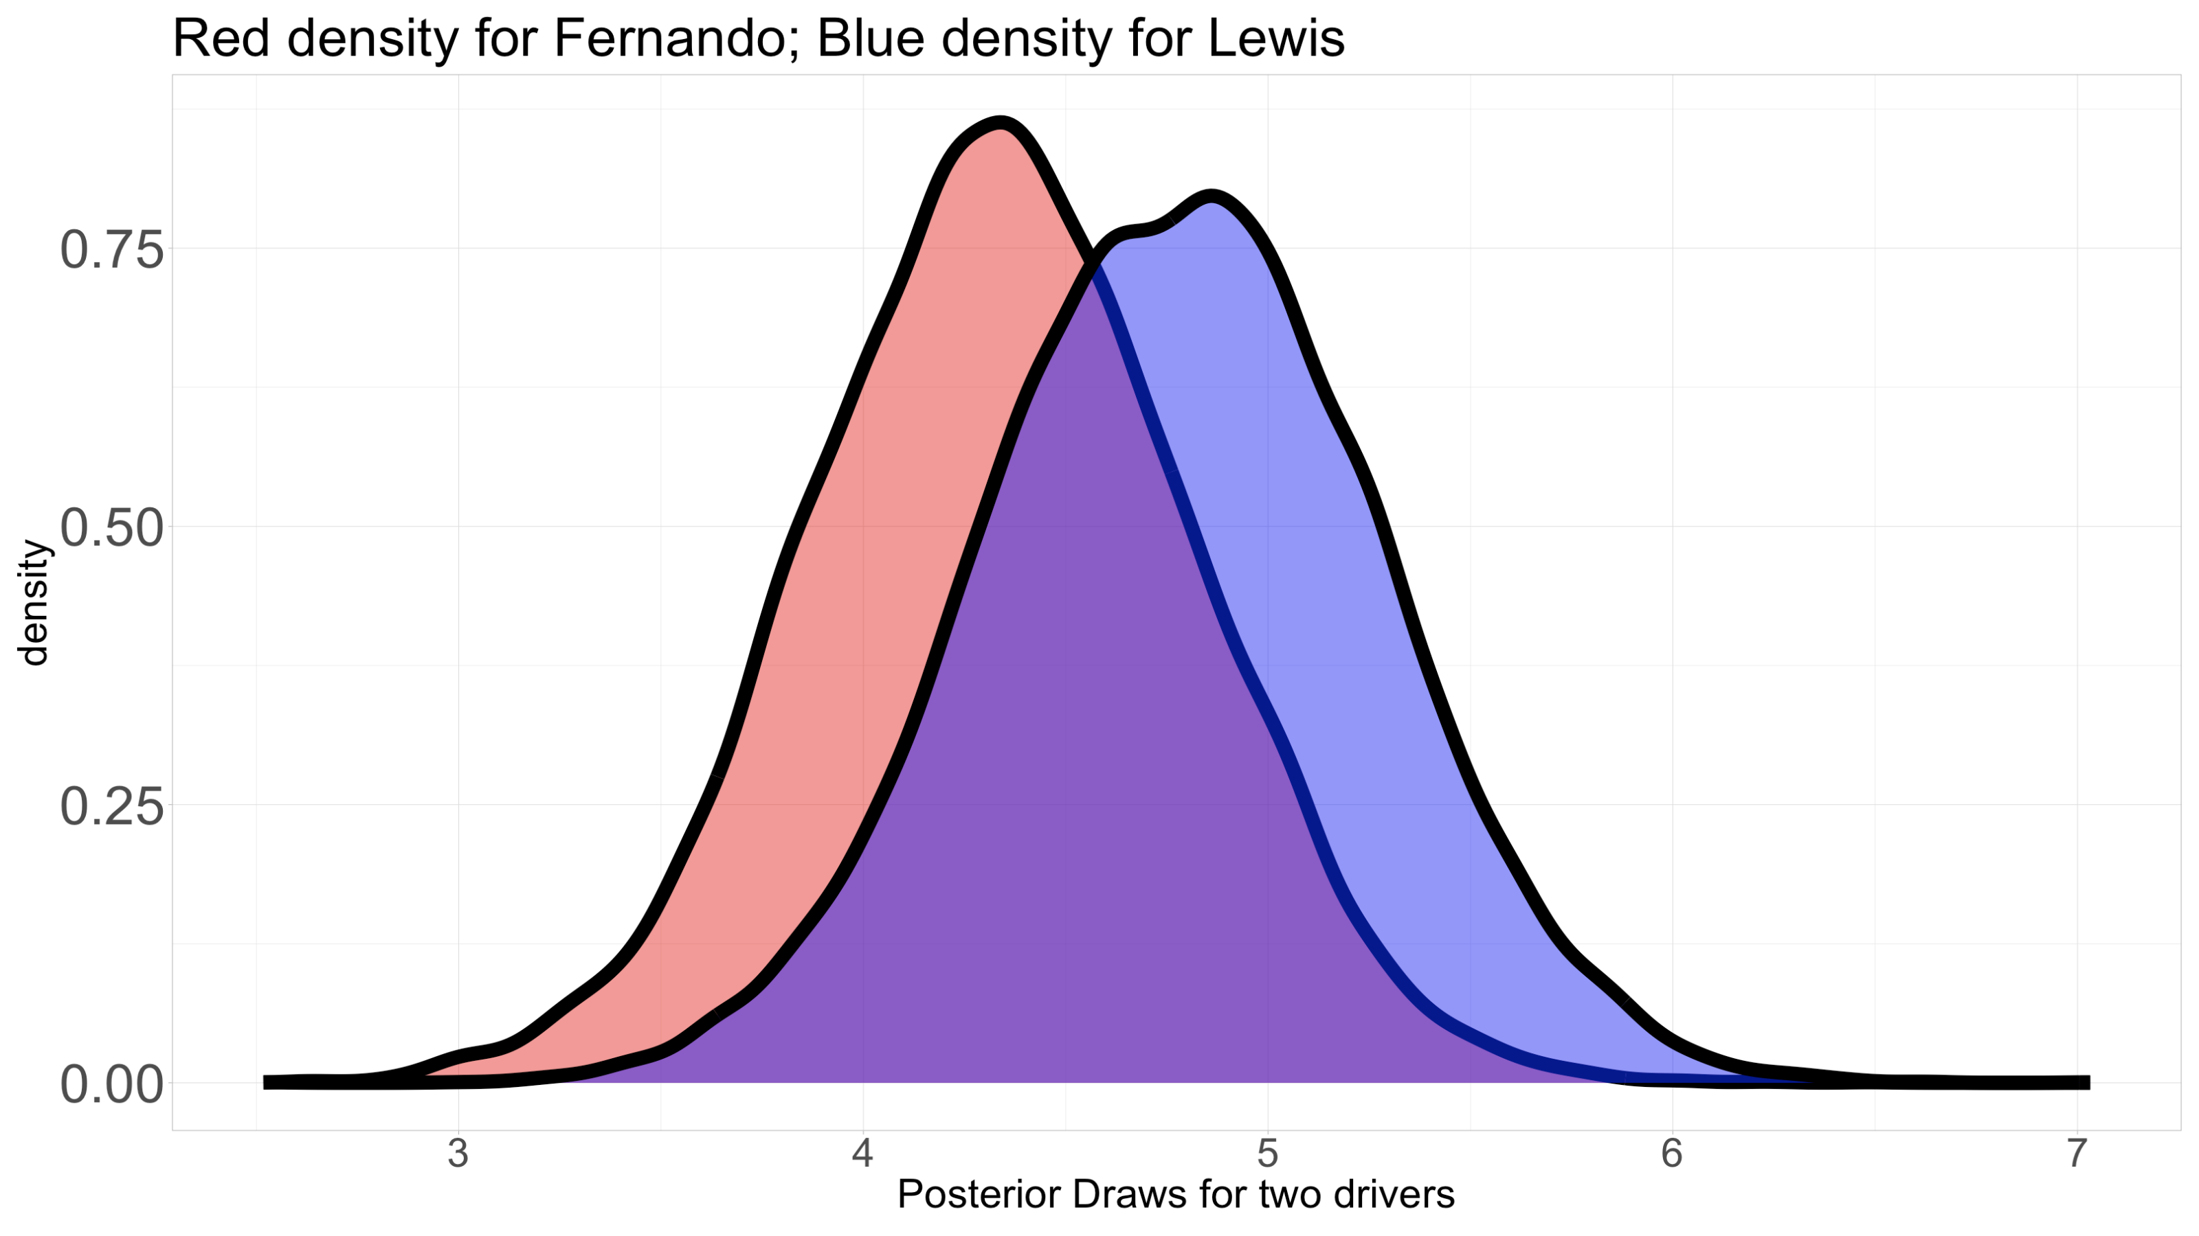
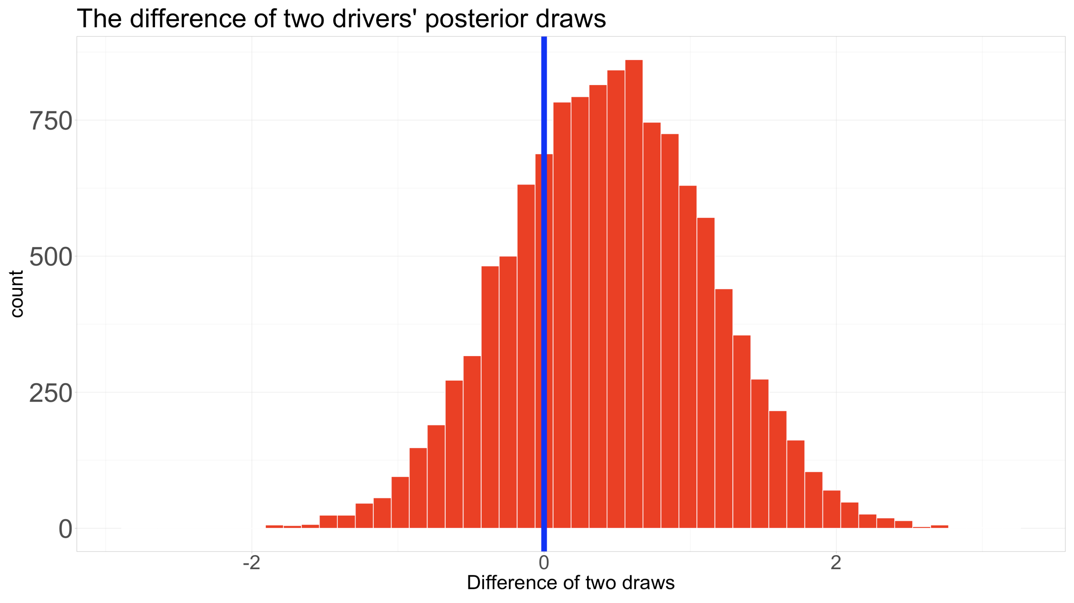

Bayesian Linear Mixed Model
– Posterior Inference for drivers
Let’s further compare these two most competing drivers
Calculate the difference between two drivers’ posterior draws
The highest density interval is $\left[−0.89, 1.76\right]$
We have 73% confidence that Lewis performs better than Fernando

Slide 55
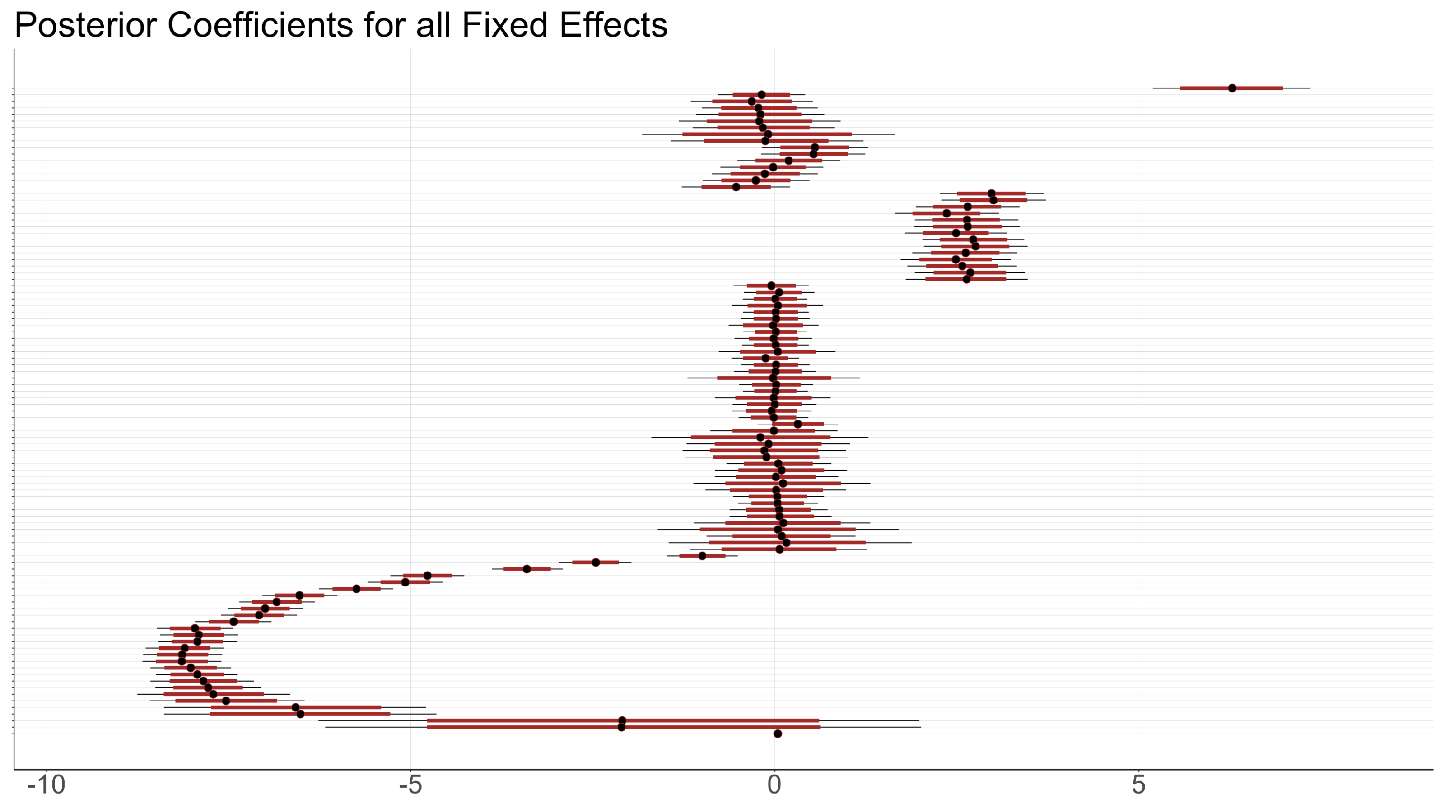
Bayesian Linear Mixed Model
– Posterior Inference for Year, Circuit, Qualify, Age
Posterior Coefficients for all fixed effect variables

Slide 56
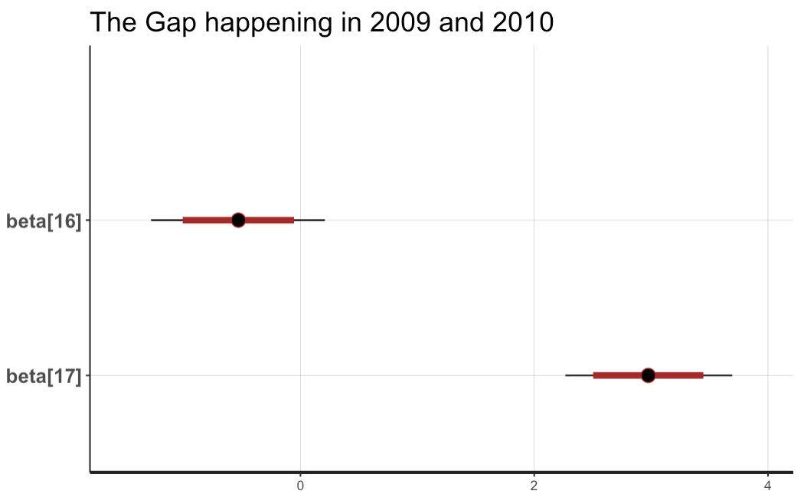
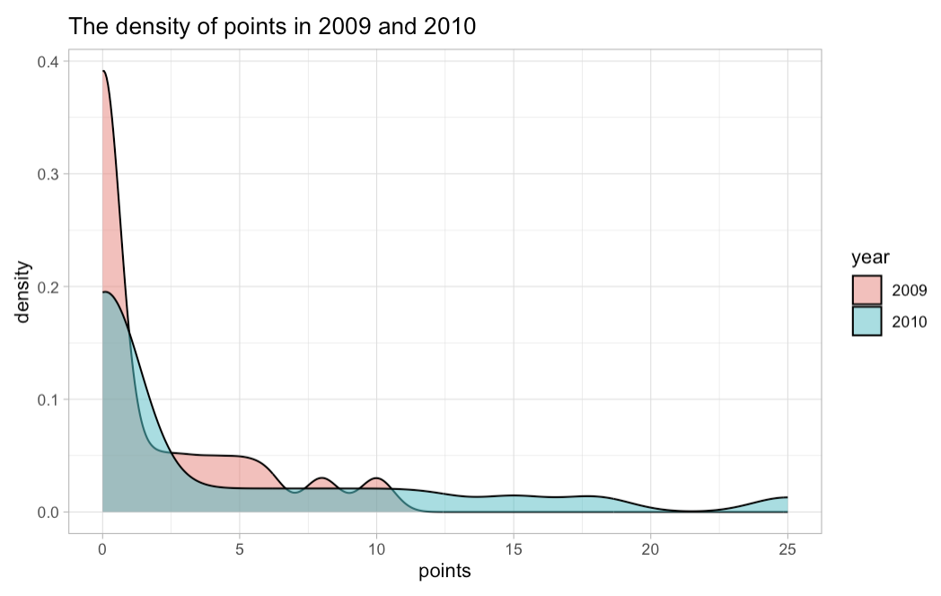
Bayesian Linear Mixed Model
– Posterior Inference for Year
The mean of posterior coefficients for 2010 is 3.5 unit larger than that in 2009
There was a significant change in point system in 2010.

Slide 57
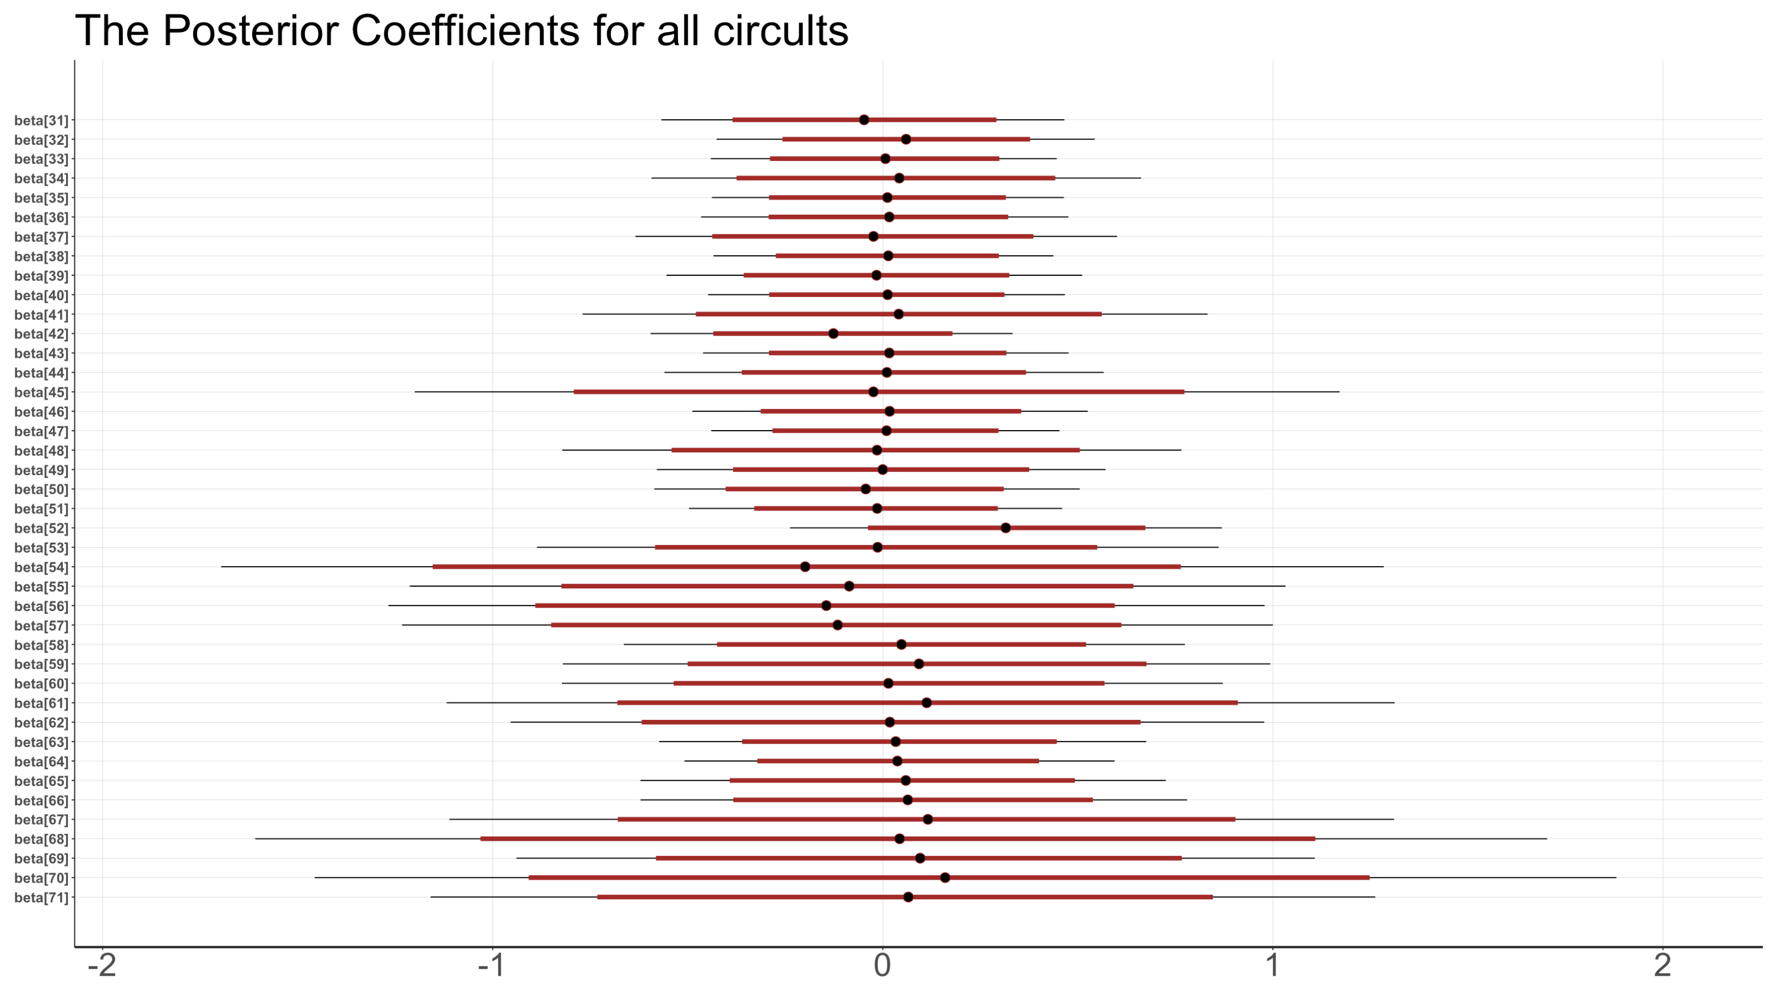
Bayesian Linear Mixed Model
– Posterior Inference for Circuit
As we can see, Yas Marina Circuit in Abu Dhabi generally produces 0.3 unit larger points than all other circuits on average.

Slide 58

Bayesian Linear Mixed Model
– Posterior Inference for Circuit
Yas Marine is the most advanced luxurious Grand Prix in the world.
This circuit is known for its smooth and flowing layout.

Slide 59
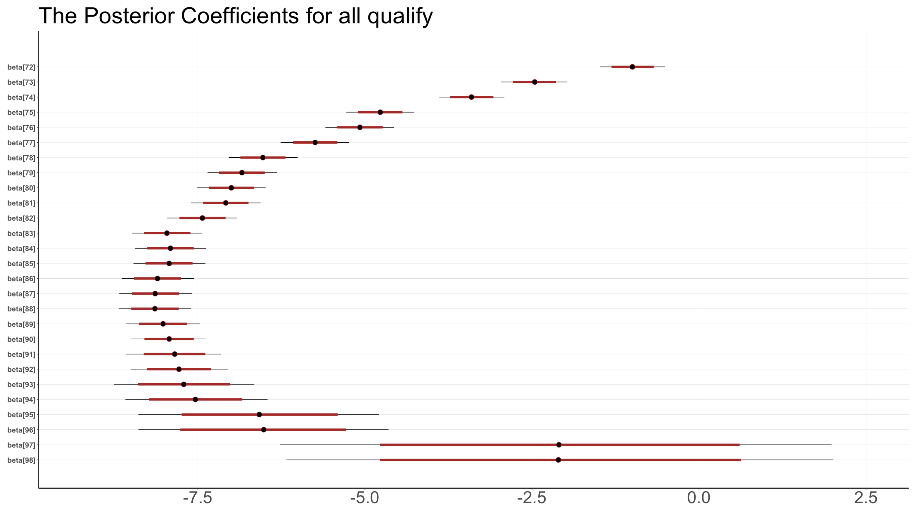
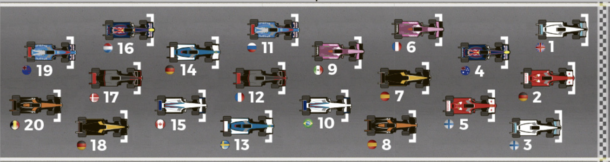
Bayesian Linear Mixed Model
– Posterior Inference for Qualify
It’s obvious that front qualify positions have more points than those in later positions.
The qualify positions from 23rd to 28th have few records in data.

Slide 60
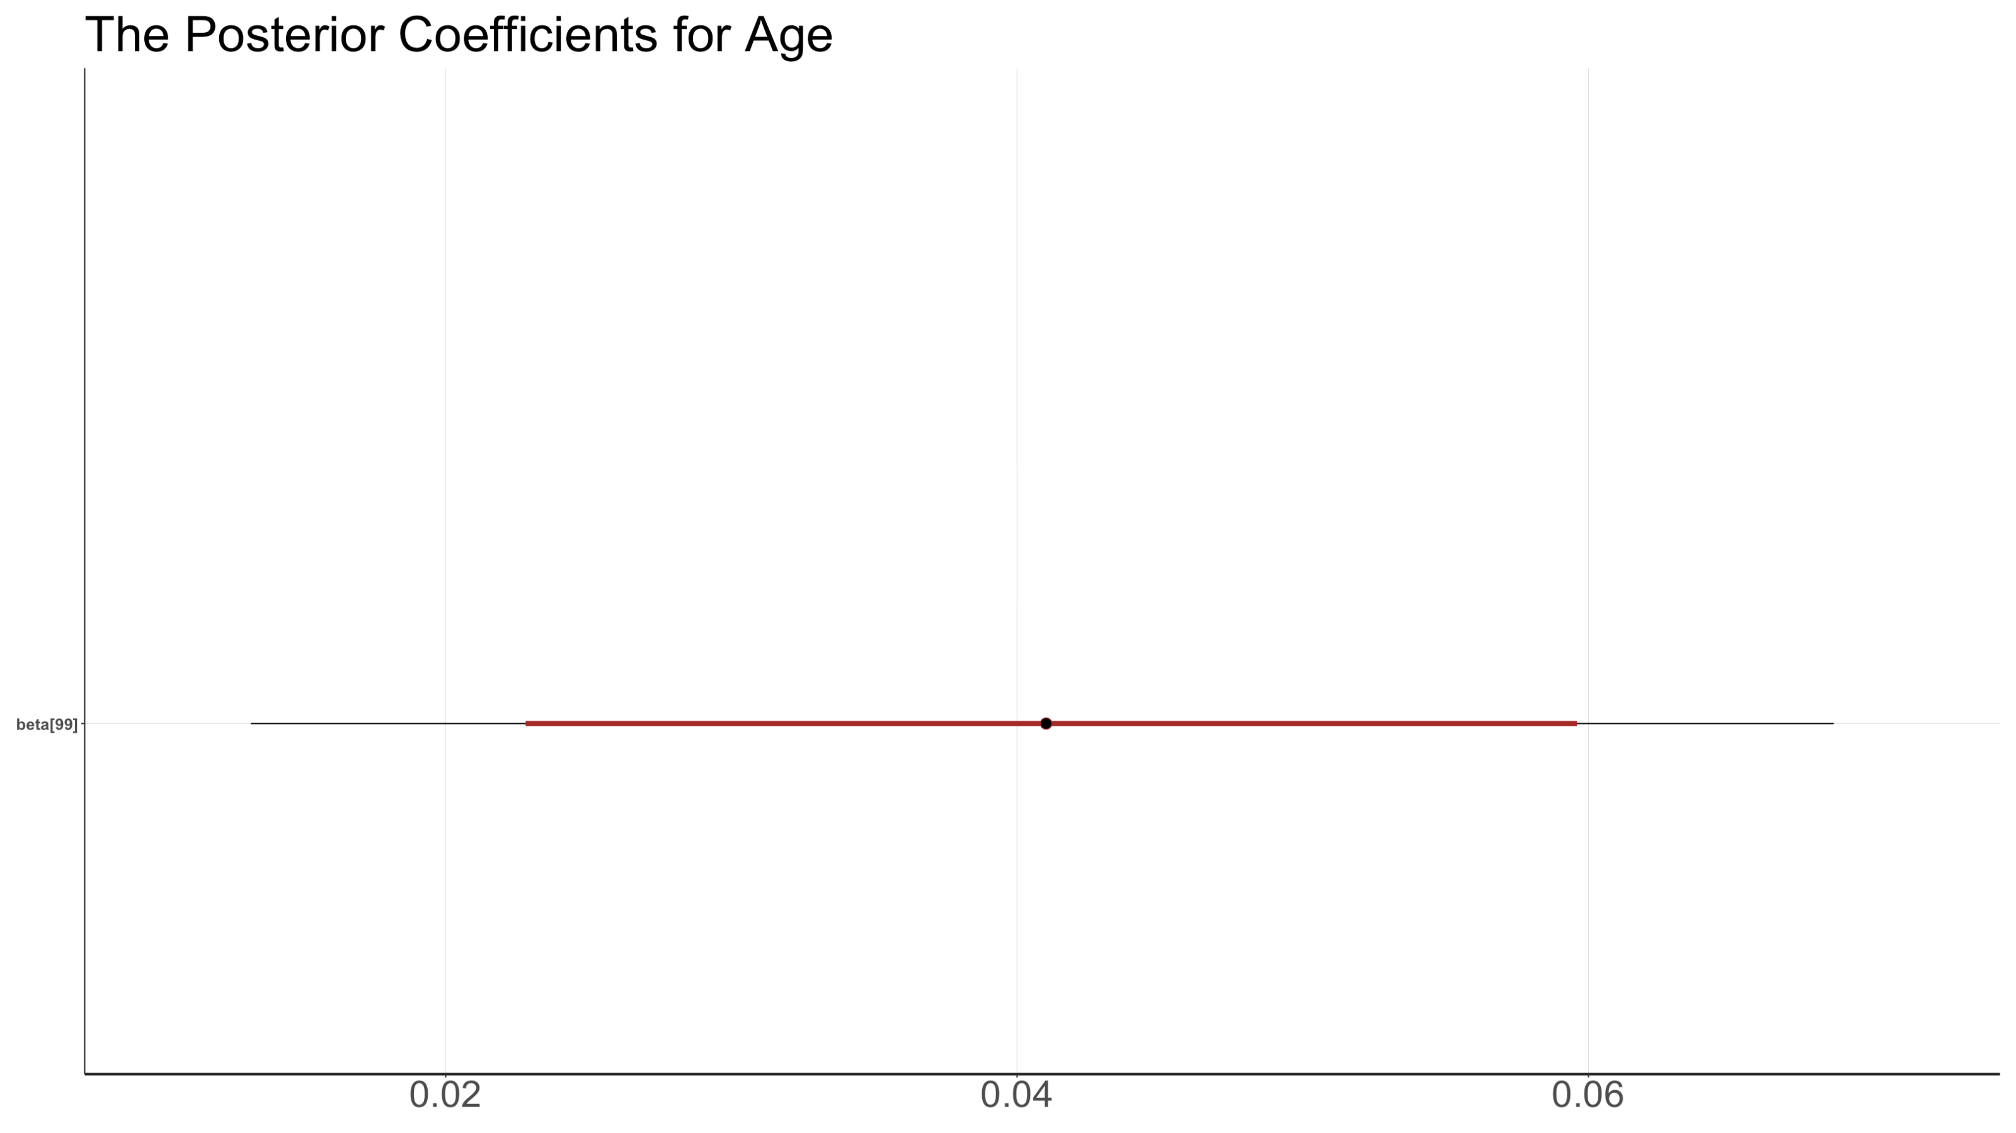
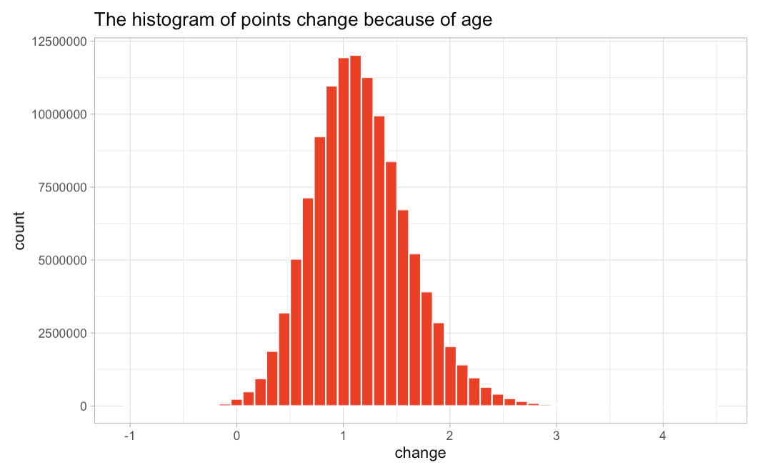
Bayesian Linear Mixed Model
– Posterior Inference for Age
The positive posterior coefficient mean older drivers may have better performance because of more experience in racing.
However, Age does not influence points a lot.

Slide 61
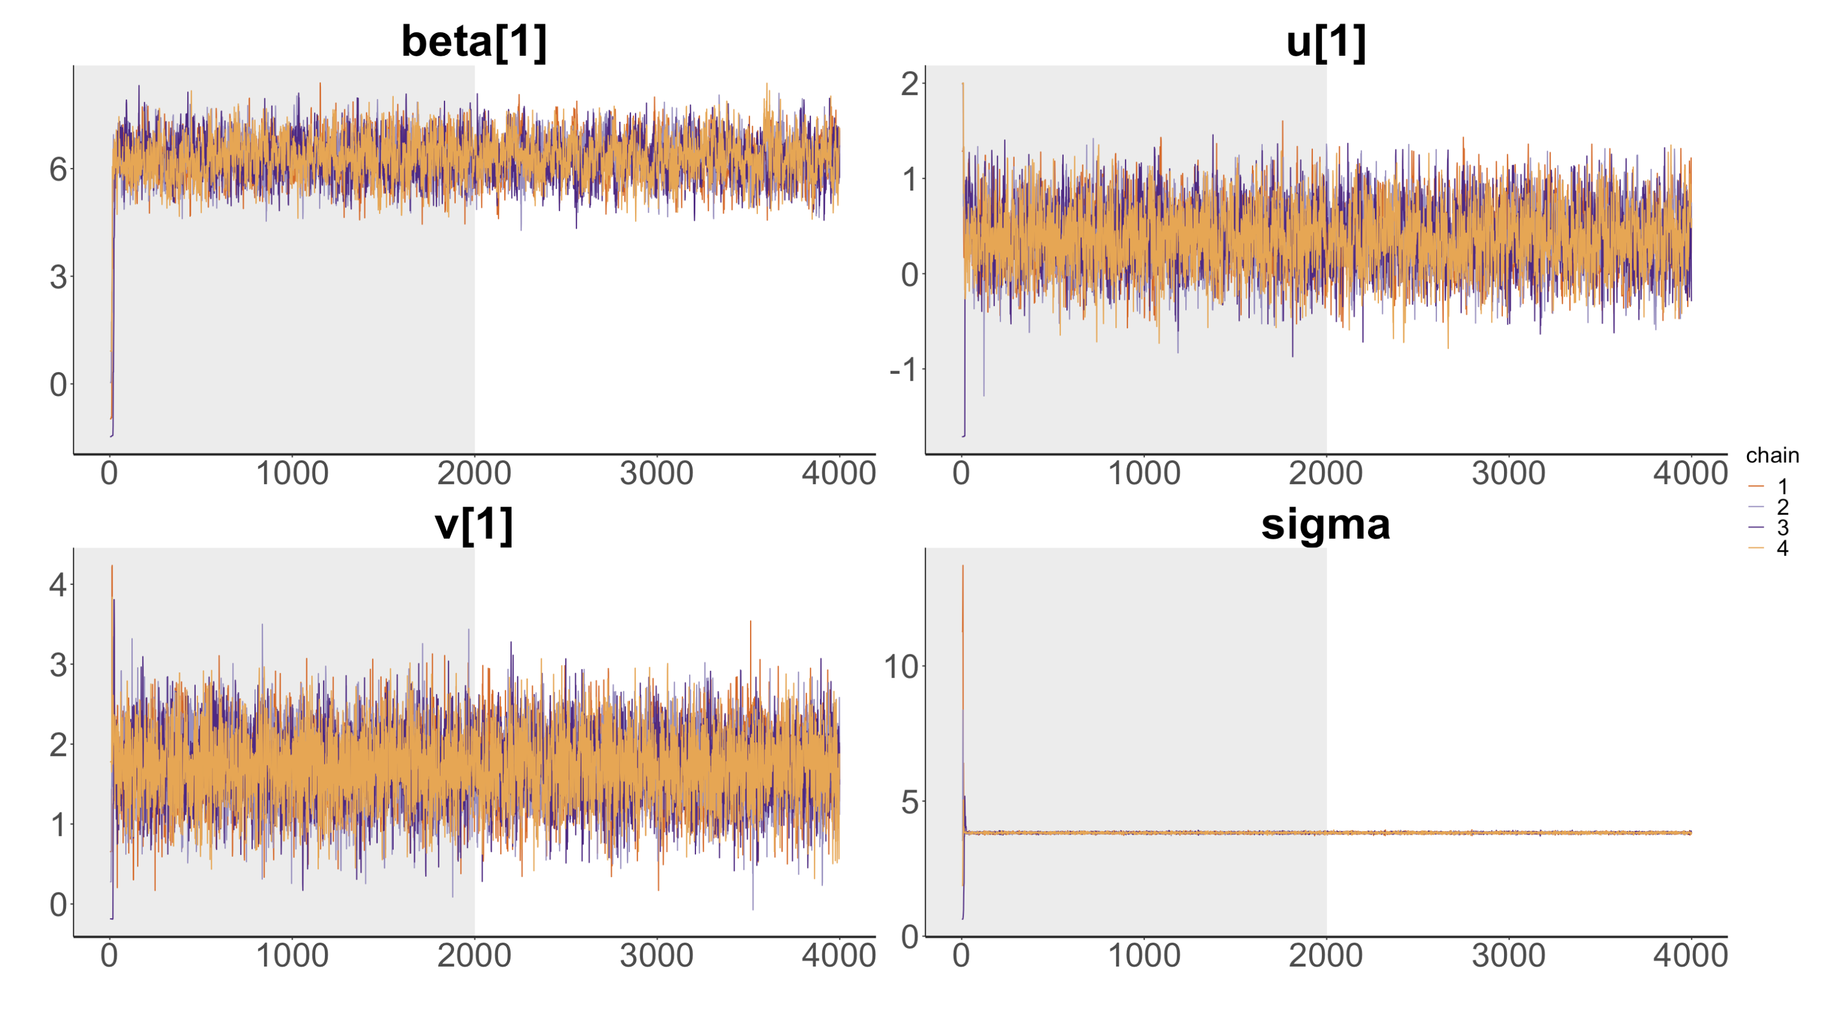
Bayesian Linear Mixed Model
– Posterior Prediction on Points
I used 4,000 iterations and 4 chains; there are 8,000 post-warmup.
It took 20 mins to run.
I used normal_rng() to draw posterior predictive samples for season 2023 at Dutch Grand Prix at 2023-08-27 that does not exist in my data.
There are 19 drivers at this race to predict.
Model diagnostics is well and convergent.

Slide 62
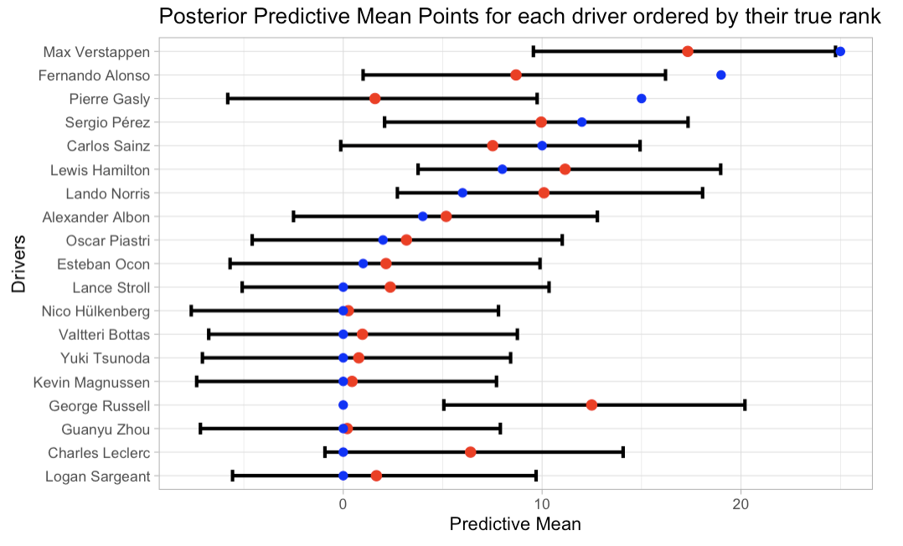
Bayesian Linear Mixed Model
– Posterior Prediction on Points
For first three ranked drivers, their true points are larger than uppers of HDI.
For most middle-ranked drivers, their true points are close to posterior mean.

Slide 63
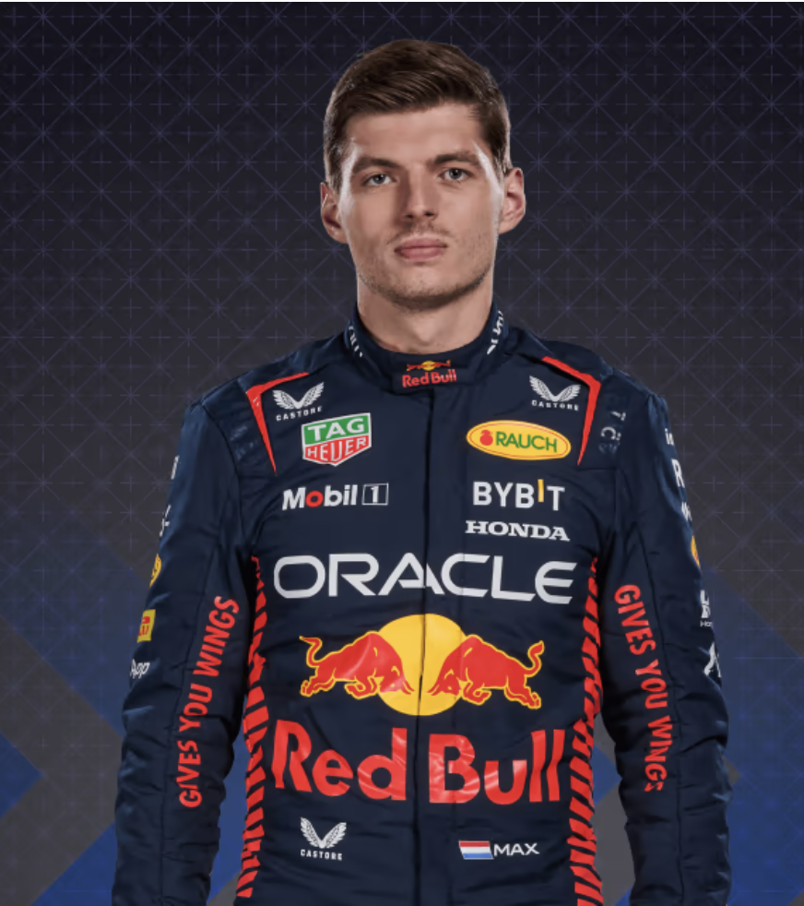
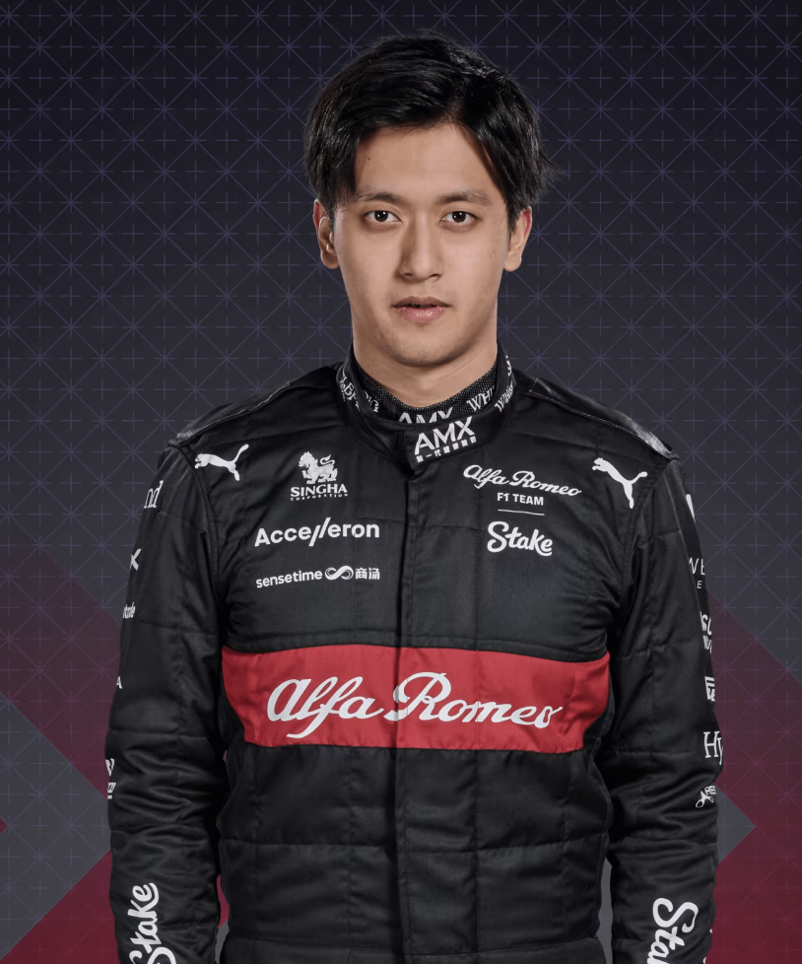
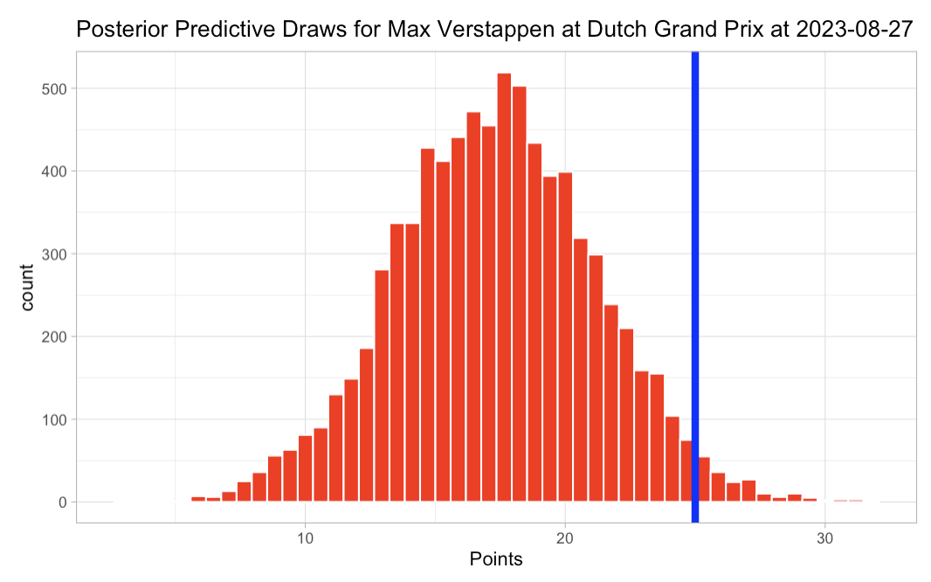
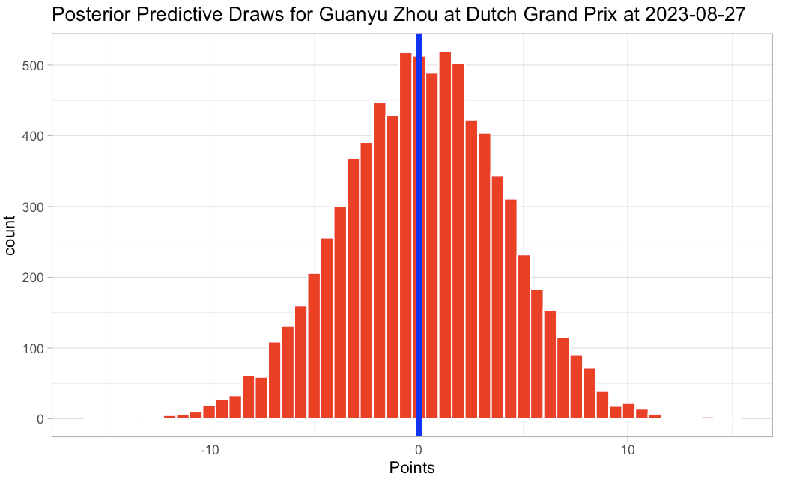
Bayesian Linear Mixed Model
– Posterior Prediction on Points
Left is Dutch Driver: Max Verstappen
Right is Chinese Driver: Guanyu Zhou

Slide 64
Linear Regression,
Random Forest,
XGBoost with tidymodels framework
The same data used in previous Bayesian models.
Remove drivers who participated less than 20 races in F1.
Remove qualify position from 23rd to 28th because of old system.
Data have 9090 rows and 7 columns; 80% for training and 20% test.
Year, Circuit, driver, constructor, qualify are factored and dummied.
Age is scaled and centered.
Hyper-tune with resampling training into 8 folds and repeat 4 times.
Resample is stratified by constructor.

Slide 65
Linear Regression,
Random Forest,
XGBoost
After training and testing, Linear Regression performs the best
Random Forest and XGBoost perform very closely.
Model | Train RMSE | Test RMSE | Standard Error
Linear Regression | 3.93 | 4.22
Random Forest | 4.43 | 4.50 | 0.02
XGBoost | 4.42 | 4.57 | 0.02
Model | mtry | min n | Tree Depth | Learn Rate
Random Forest | 5 | 22
XGBoost | 3 | 16 | 1114 | 0.03

Slide 66
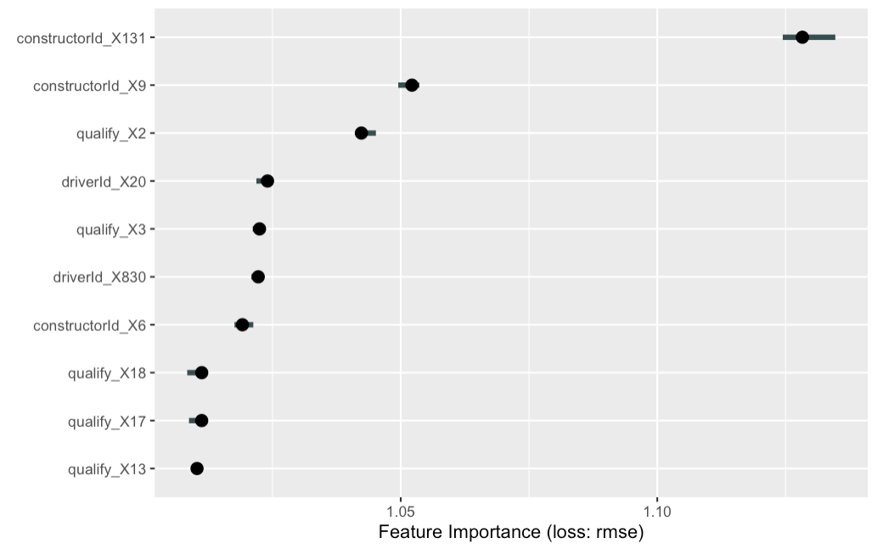
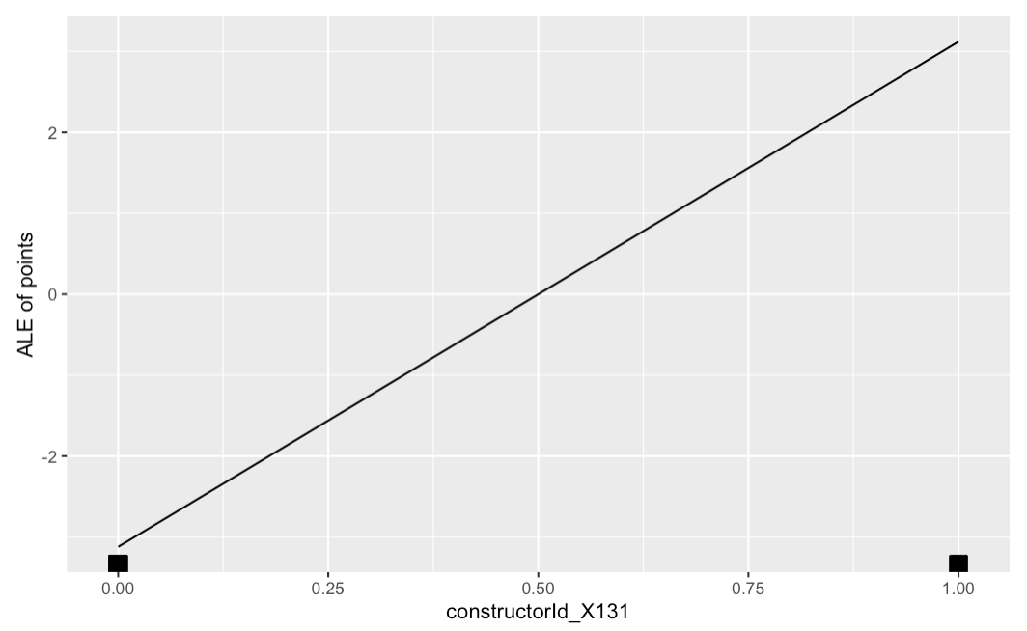
XGBoost
- variable importance
Constructor: Mercedes is the most influential level.
Mercedes helps drivers gain more points in straight line.

Slide 67
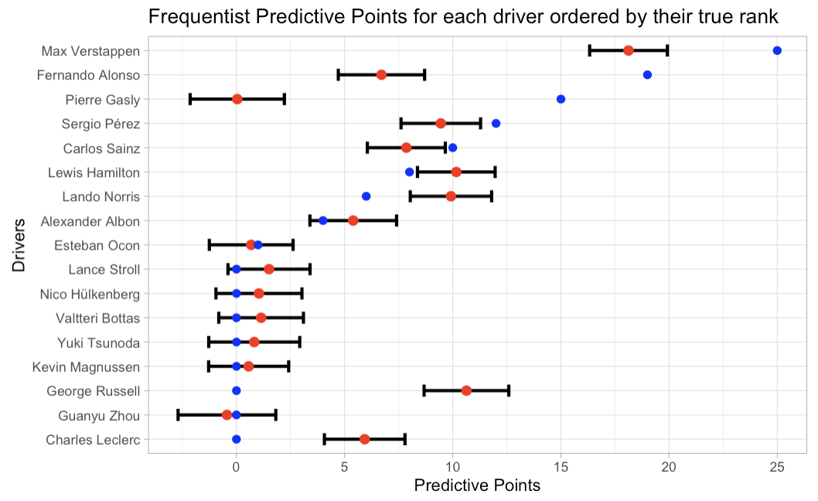
Compare Bayesian and Frequentist
Compare them on the season 2023 in Dutch Grand Prix on Aug. 27.
Bayesian performs better than Frequentist.
Bayesian also performs better than Random Forest and XGBoost.
Model | RMSE
Bayesian | 5.58
Frequentist | 5.98

Slide 68
Limitations
My Bayesian model only a few predictors that don’t represent the whole race.
The driver and constructor categorical predictors have hundreds of levels, making models have too many dummy variables.
I used a normal distribution to assume the point distribution, however points are discrete for each race.
I used normal distributions to assume my prior parameters’ distributions.

Slide 69
Future Work
Make more feature engineering to represent races closer, for example pit stop, lap time, accidents, overtaking
Only use drivers and constructors that participate in races over 10 years to have sufficient data and less categorical levels
Formula One point system is discrete and contains excess zero, so I should consider to use zero-inflated Poisson distribution to assume outcome variable, points
Try to different prior distributions for parameters and compare prediction results

Slide 70
Conclusions
Mercedes and Red Bull are two most powerful car manufacturer
Fernando Alonso from Ferrari and Lewis Hamilton from Mercedes are two most excellent racers.
Yas Marine Circuit makes drivers get more points in general.
Qualify positions have major influence on race points.
Age does not affect drivers’ performance a lot.
Prediction from all models shows in the future Max Verstappen will dominate the whole season.

